Slide 1



PROGRESS PRESENTATION 1
COCOCLARITY
Elevating Efficiency and Sustainability in Large-Scale Coconut Oil Manufacturing through Progressive Strategies
Project ID : R24-059
7/24/2024
1

Slide 2





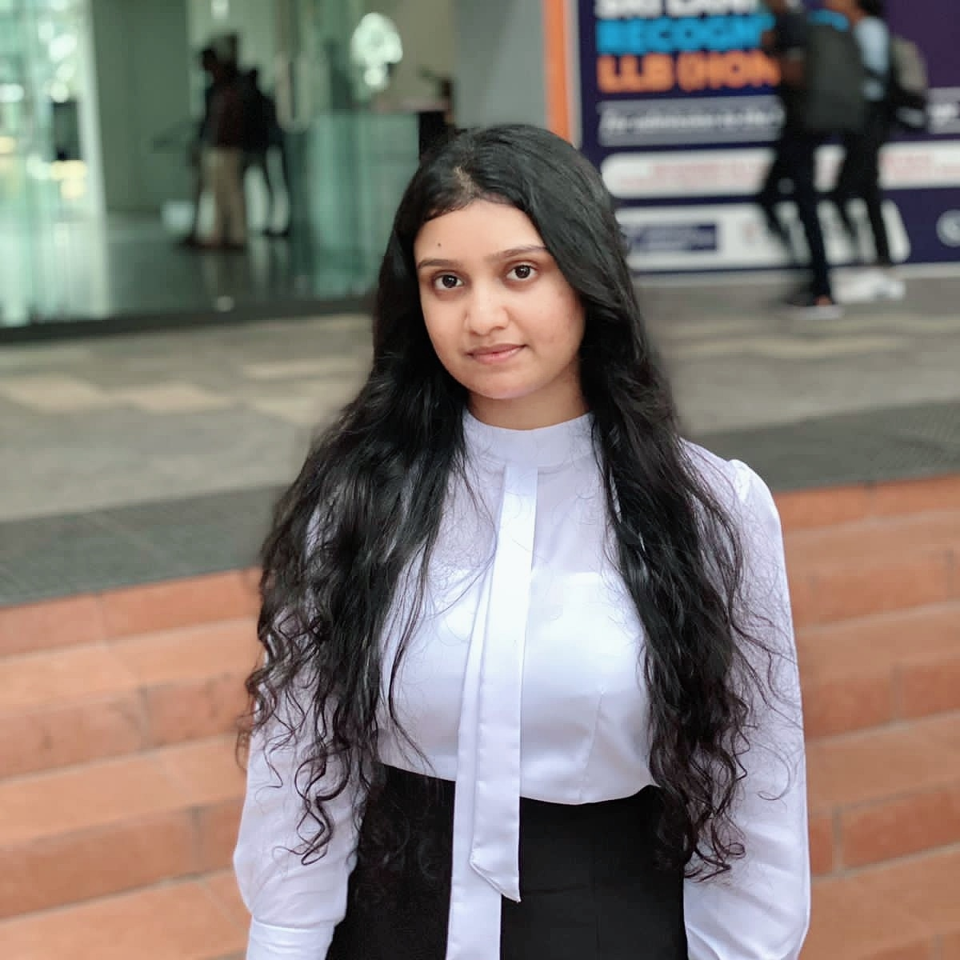

OUR TEAM
MR. NELUM AMARASENA
MS.MANORI GAMAGE
DR. Chandi Yalegama
(Head, Coconut Processing Research Division)
WELIGAMA D.M.P.D
DEWMINI A.M
BANDARA A.M.S.S
FERNANDO W.P.A.M

Slide 3
AGENDA
Introduction 4
Problem Statement 5
Research Problem 6
Objectives 7
System Overview Diagram 10
Individual Components 8
Requirements 5
Commercialization 9
Supervisor Meetings 12

Slide 4
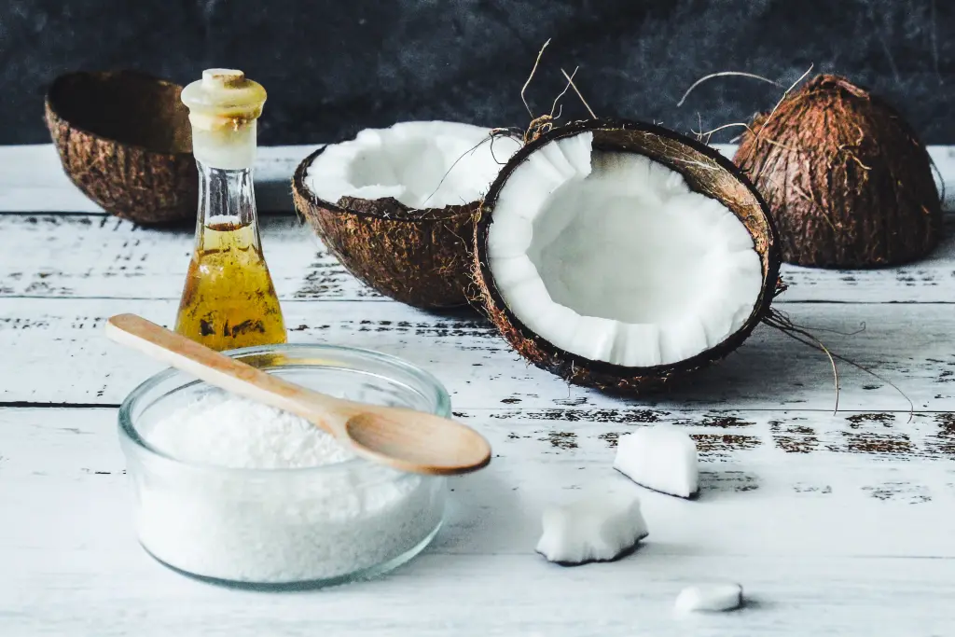


INTRODUCTION
4th largest coconut producer.
7th largest coconut oil producer.
Sri Lanka is a country rich in coconut trees
There are many ways that we can apply to Sri Lanka's coconut oil industry to increase the productivity.

Slide 5

RESEARCH PROBLEM
How to apply fast-changing AI/ML to increase sustainability and efficiency in the coconut oil industry?
Support coconut oil manufacturers to choose which oil type to be manufactured?
How much of coconut oil will be required in the future through past insights?
Provide fast coconut oil quality predicting system through smartphone with high accuracy lab test?
Provide marketing features such as finding out which countries to export to and what percentage?

Slide 6

Objectives of the Study
To build a web application and mobile application to apply AI/ML technology to coconut oil industry.
Our system,
Recommends the best coconut oil to be manufactured through the nature of the copra.
Analyses past coconut oil yields and predict future coconut oil yields.
Predicts coconut oil quality and make sure them with lab results.
Analyses the changes in the world and predict the coconut oil demand by country.
7/24/2024

Slide 7
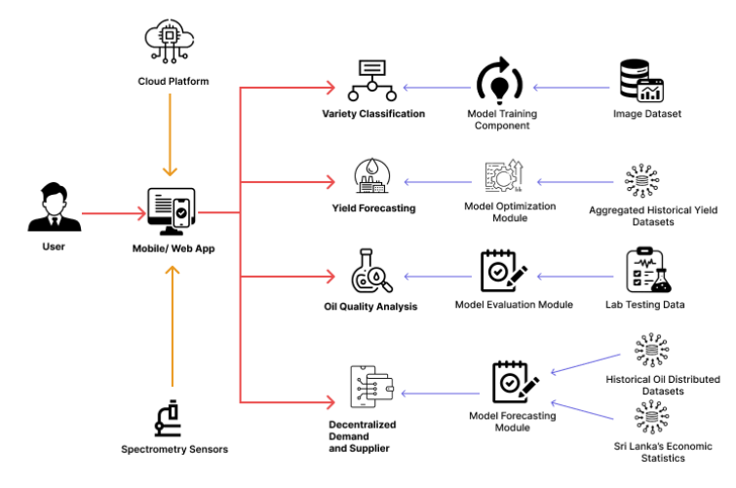
SYSTEM DIAGRAM

Slide 8


IT21061066 | WELIGAMA D.M.P.D
IT Specialization
Coconut (Copra) Variety Assistant
IT21061066 | WELIGAMA D.M.P.D | RP-059
7/24/2024 8

Slide 9
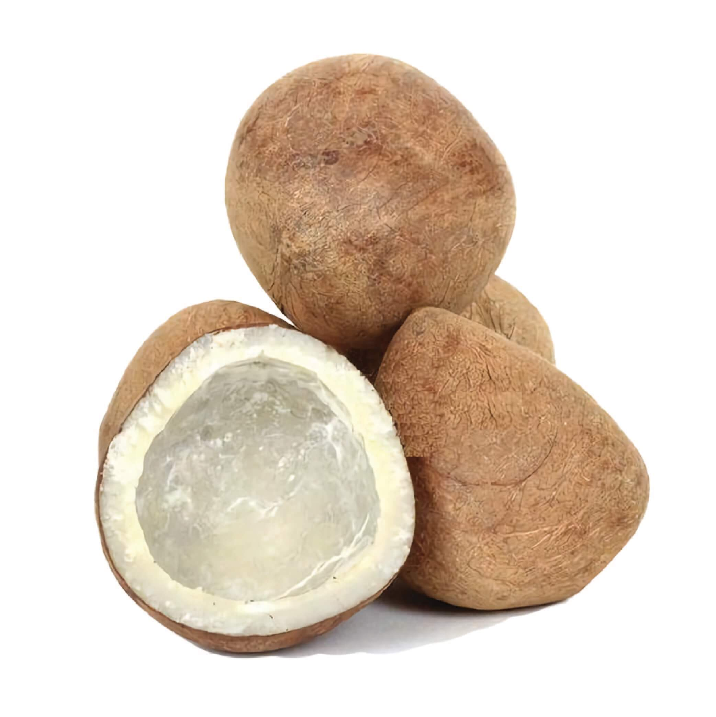
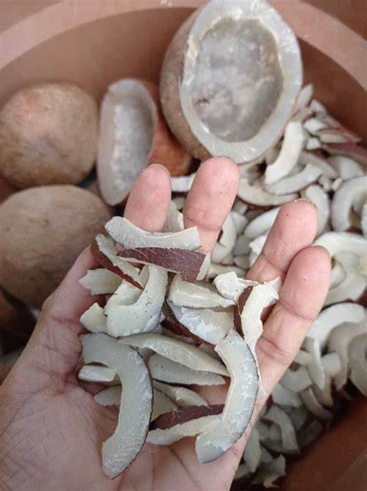
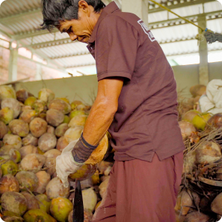
Background of the Study
What is the importance of accurate coconut variety(copra) identification for large-scale coconut oil producers?
What are the challenges with manual or traditional methods of copra identification?
How could technology like deep learning enhance copra identification and recommendations?
IT21061066 | WELIGAMA D.M.P.D | RP-059

Slide 10


RESEARCH PROBLEM
Limited technology adoption restricts productivity gains?
Imprecise manual identification causes output variability?
Underutilization of available variety data patterns?
Lack of tailored recommendations for large-scale producers?
IT21061066 | WELIGAMA D.M.P.D | RP-059
7/24/2024

Slide 11
Research Gap of the Study
Insufficient datasets of local coconut varieties
RGB-Infrared fusion unexplored for better identification
Graph neural networks unused to model variety relations
Tensor factorization absent in feature extraction
Explainability of predictions needs enhancement
Linking visual markers to environment lacking
Optimizing models for edge devices unaddressed
IT21061066 | WELIGAMA D.M.P.D | RP-059

Slide 12

Objectives of the Study
MAIN OBJECTIVES
Empower large-scale coconut oil producers to enhance productivity and product quality through accurate coconut variety identification and data-driven recommendations.
SUB OBJECTIVES
Leveraging transfer learning for variety prediction
Harnessing multi-modal data for robust outputs
Sustaining performance via user-driven model updates
7/24/2024
IT21061066 | WELIGAMA D.M.P.D | RP-059

Slide 13
NOVELTY
Utilize deep learning algorithms to analyze user-captured coconut images and accurately identify cultivars, hybrids, and age. Integrate RGB, infrared, and hyperspectral images for accurate copra identification, using fusion techniques for enhanced recommendation
Model coconut varieties as a graph, employing GNNs to enhance variety identification by capturing complex dependencies.
Represent coconut images as tensors, apply factorization for feature extraction, and fusion for personalized recommendations.
IT21061066 | WELIGAMA D.M.P.D | RP-059

Slide 14
METHODOLOGY
Data Collection
Data Visualization
Data pre-processing
Host the finalized model in the flask server
Data augmentation and the best technique to retrain models to selected achieve good
Displayed the results in mobile application
IT21061066 | WELIGAMA D.M.P.D | RP-059

Slide 15
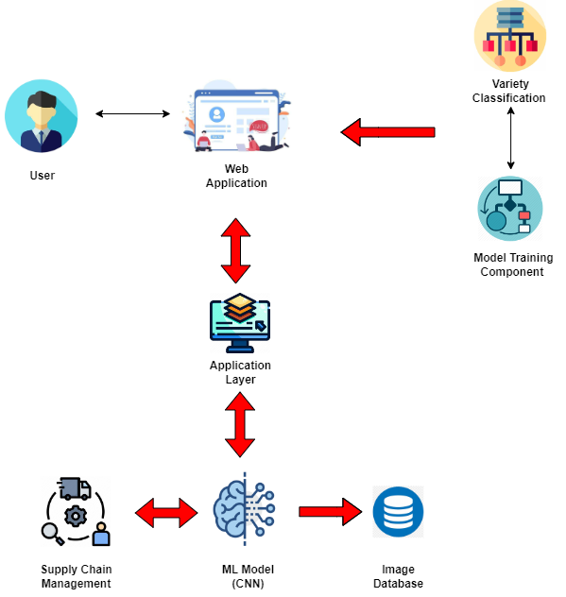
COMPONENT DIAGRAM
Mobile App
7/24/2024
IT21061066 | WELIGAMA D.M.P.D | RP-059

Slide 16
REQUIREMENTS
Variety model has 0.85+ F1-score
Real-time processing < 5 secs per image
Support heavy concurrent usage
Secure cloud data integrations
Well documented APIs
Inbuilt data validation checks
Functional Requirements
Non-Functional Requirements
Image uploads via web/mobile
CNN-based model for variety analysis
Variety, age, traits recognition
Integrate external/environment data
Generate personalized recommendations
Explain variety predictions visually
Incremental model updates
IT21061066 | WELIGAMA D.M.P.D | RP-059

Slide 17

Completion of project ​ ​
Find the image data set about copra
Collecting test dataset to improve accuracy
Identification of best model for image processing
Combined and Train the model(Convolutional Neural Network(CNN)) for predict copra quality
Train the model for predict copra quality
Implement of the backend
Design a UI for System
Implement of the frontend
Completed Works
Future Works
IT21061066 | WELIGAMA D.M.P.D | RP-059

Slide 18
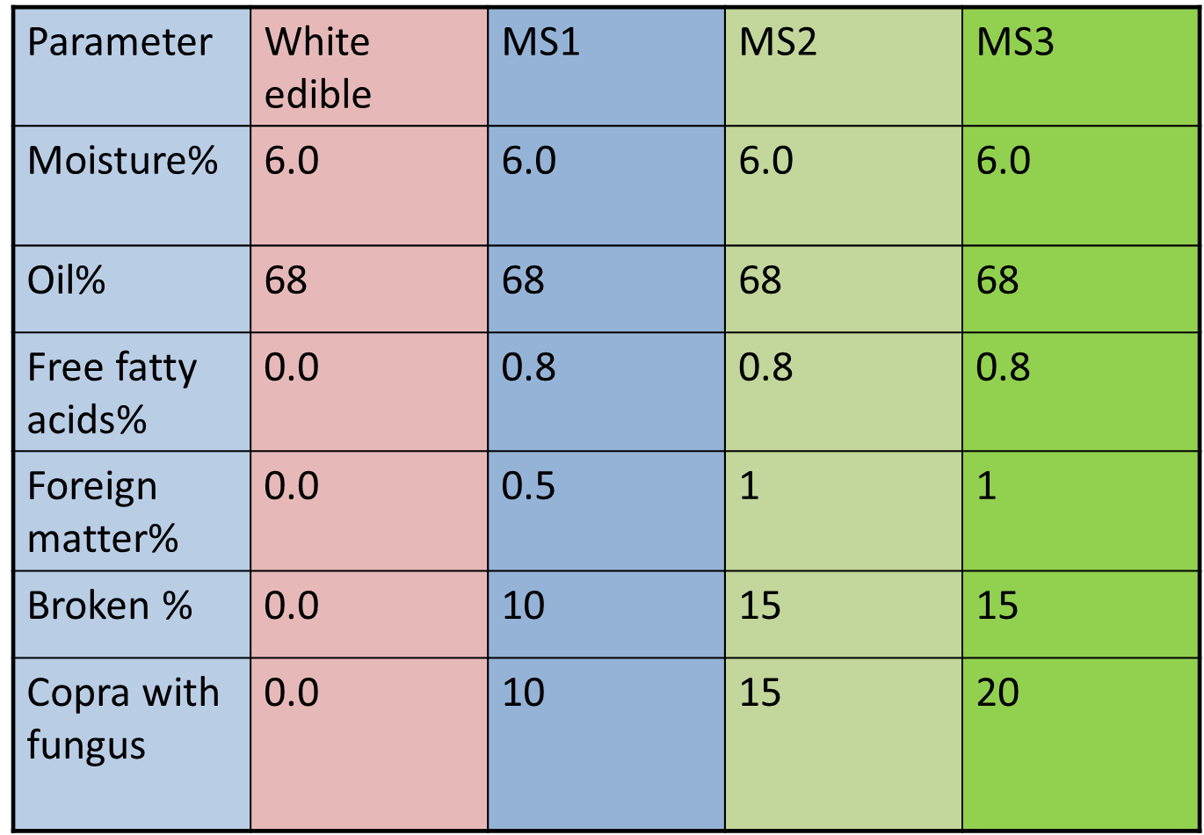


Completion of project [Contd] Data Collection
Sri Lankan standards for copra of milling superior quality

Slide 19
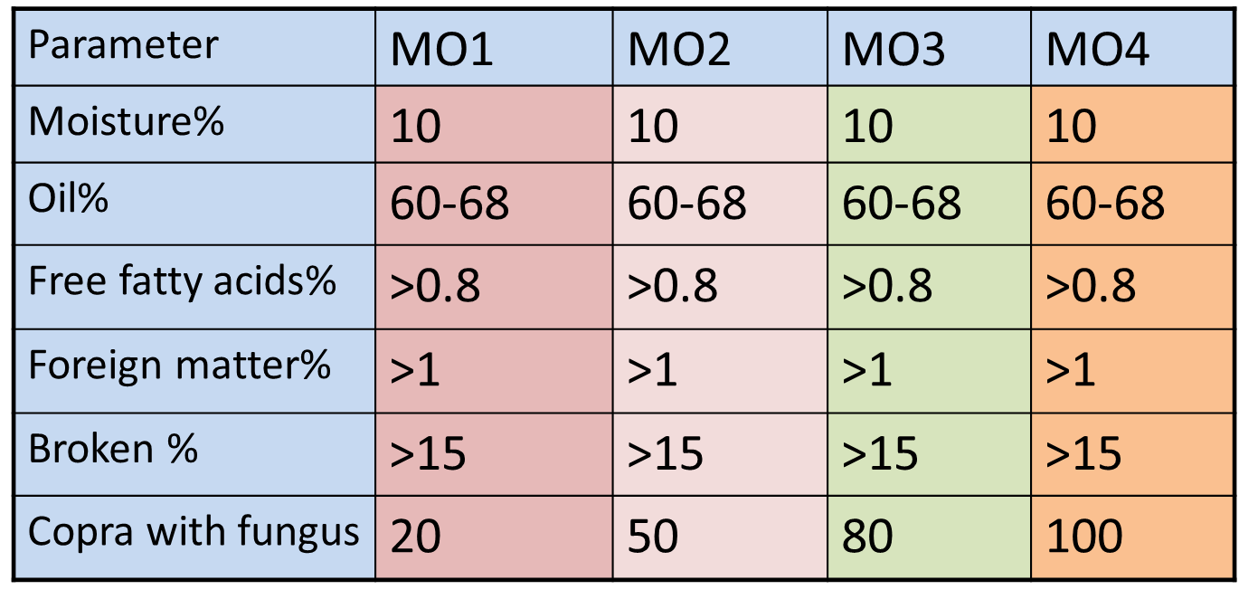
Data Collection
Sri Lankan standards for copra of MO grade

Slide 20
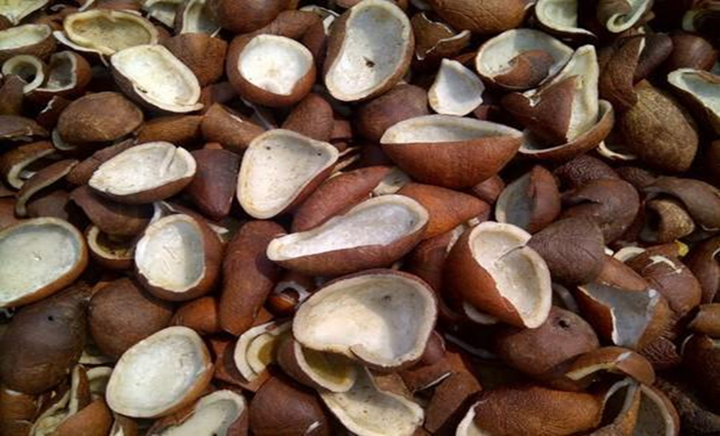
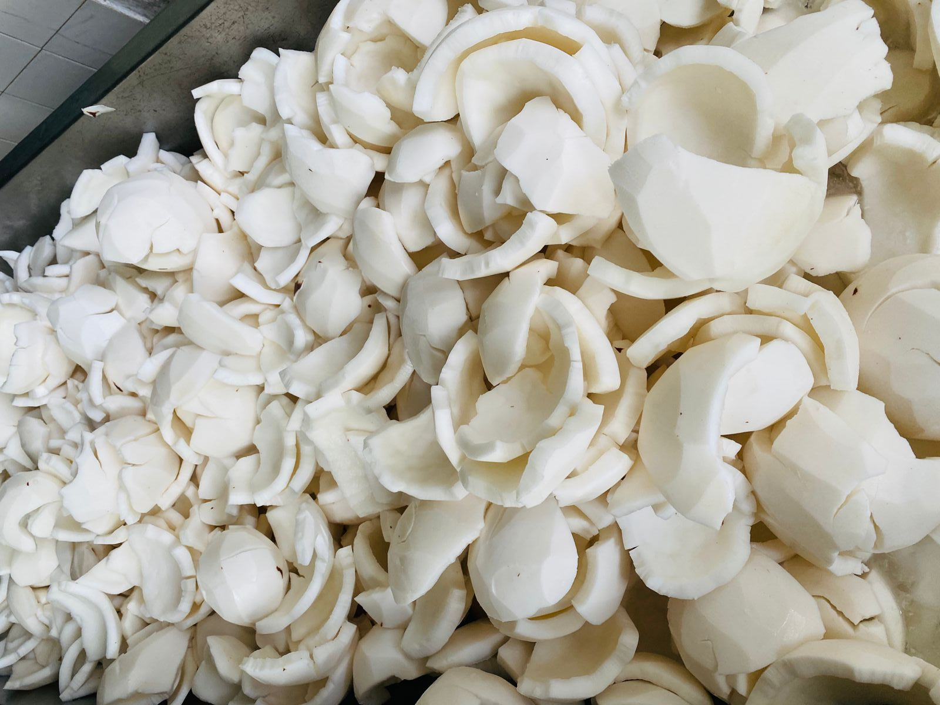
Data Collection
Copra Quality Levels:
Level 1: Define the characteristics of "perfect condition" copra for oil production. Category - [A]
Level 2: Specify the characteristics of "moderate" copra and its suitability for oil production. Category - [B]
Level 3: Define the characteristics of copra considered "not most suitable" for oil production. Category - [C]

Slide 21
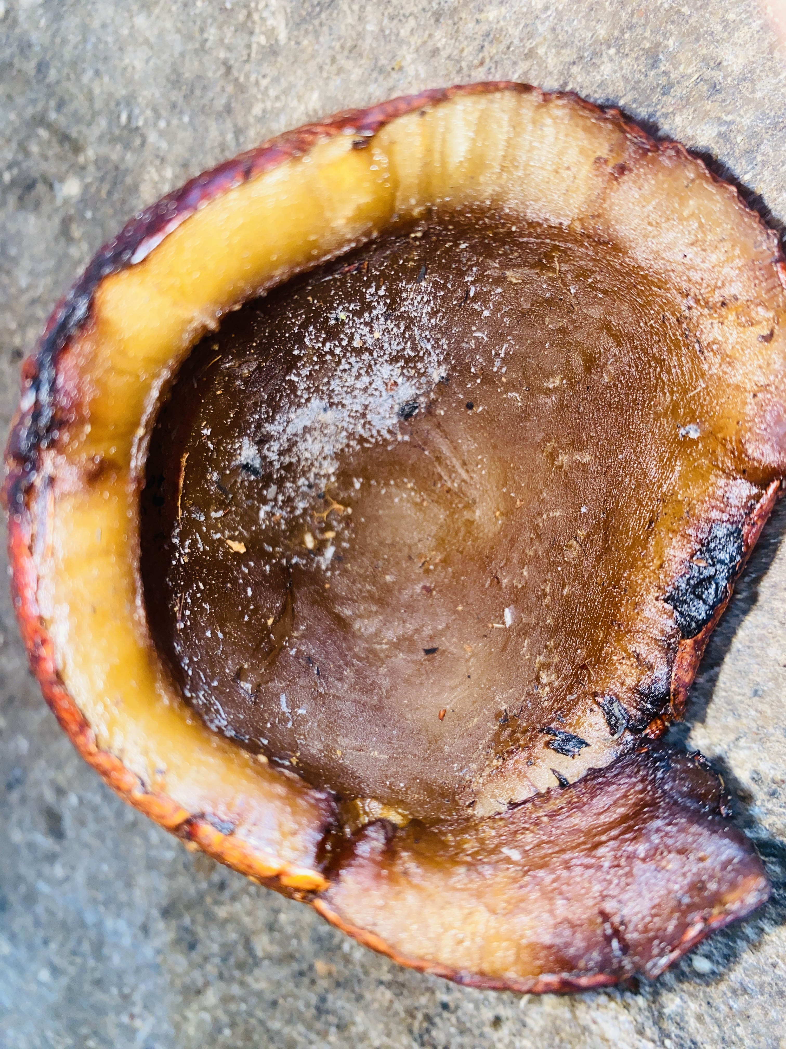
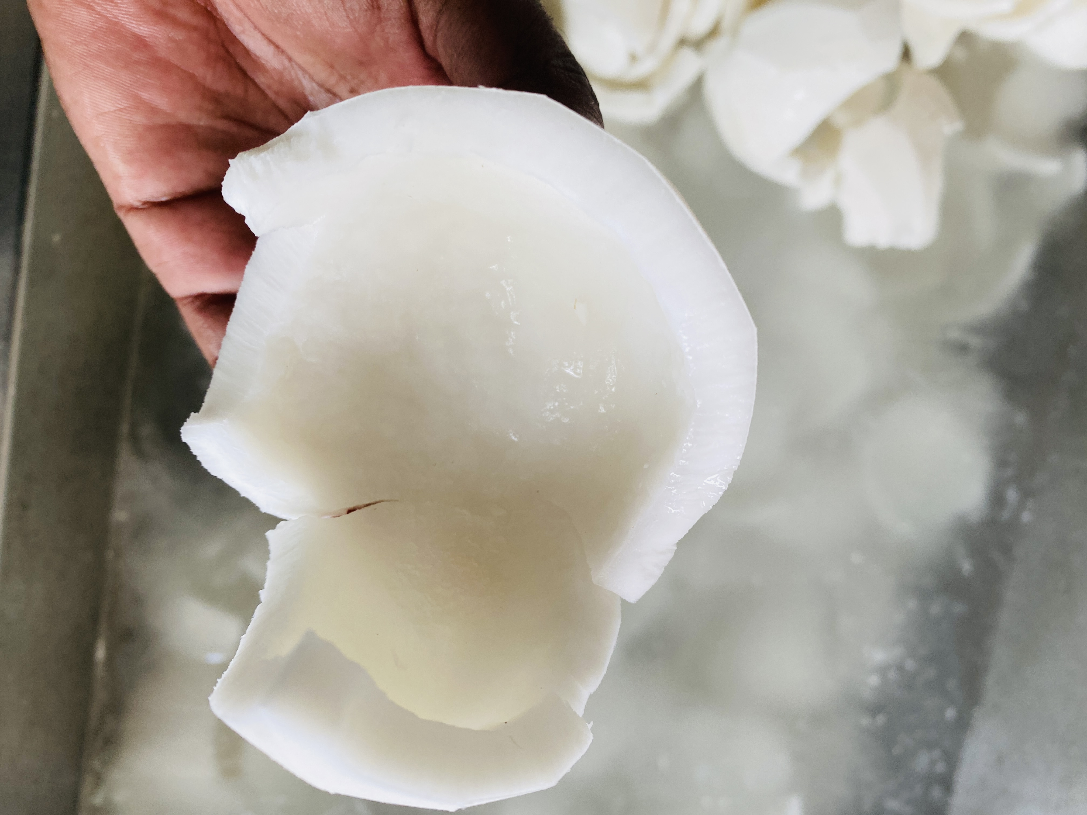
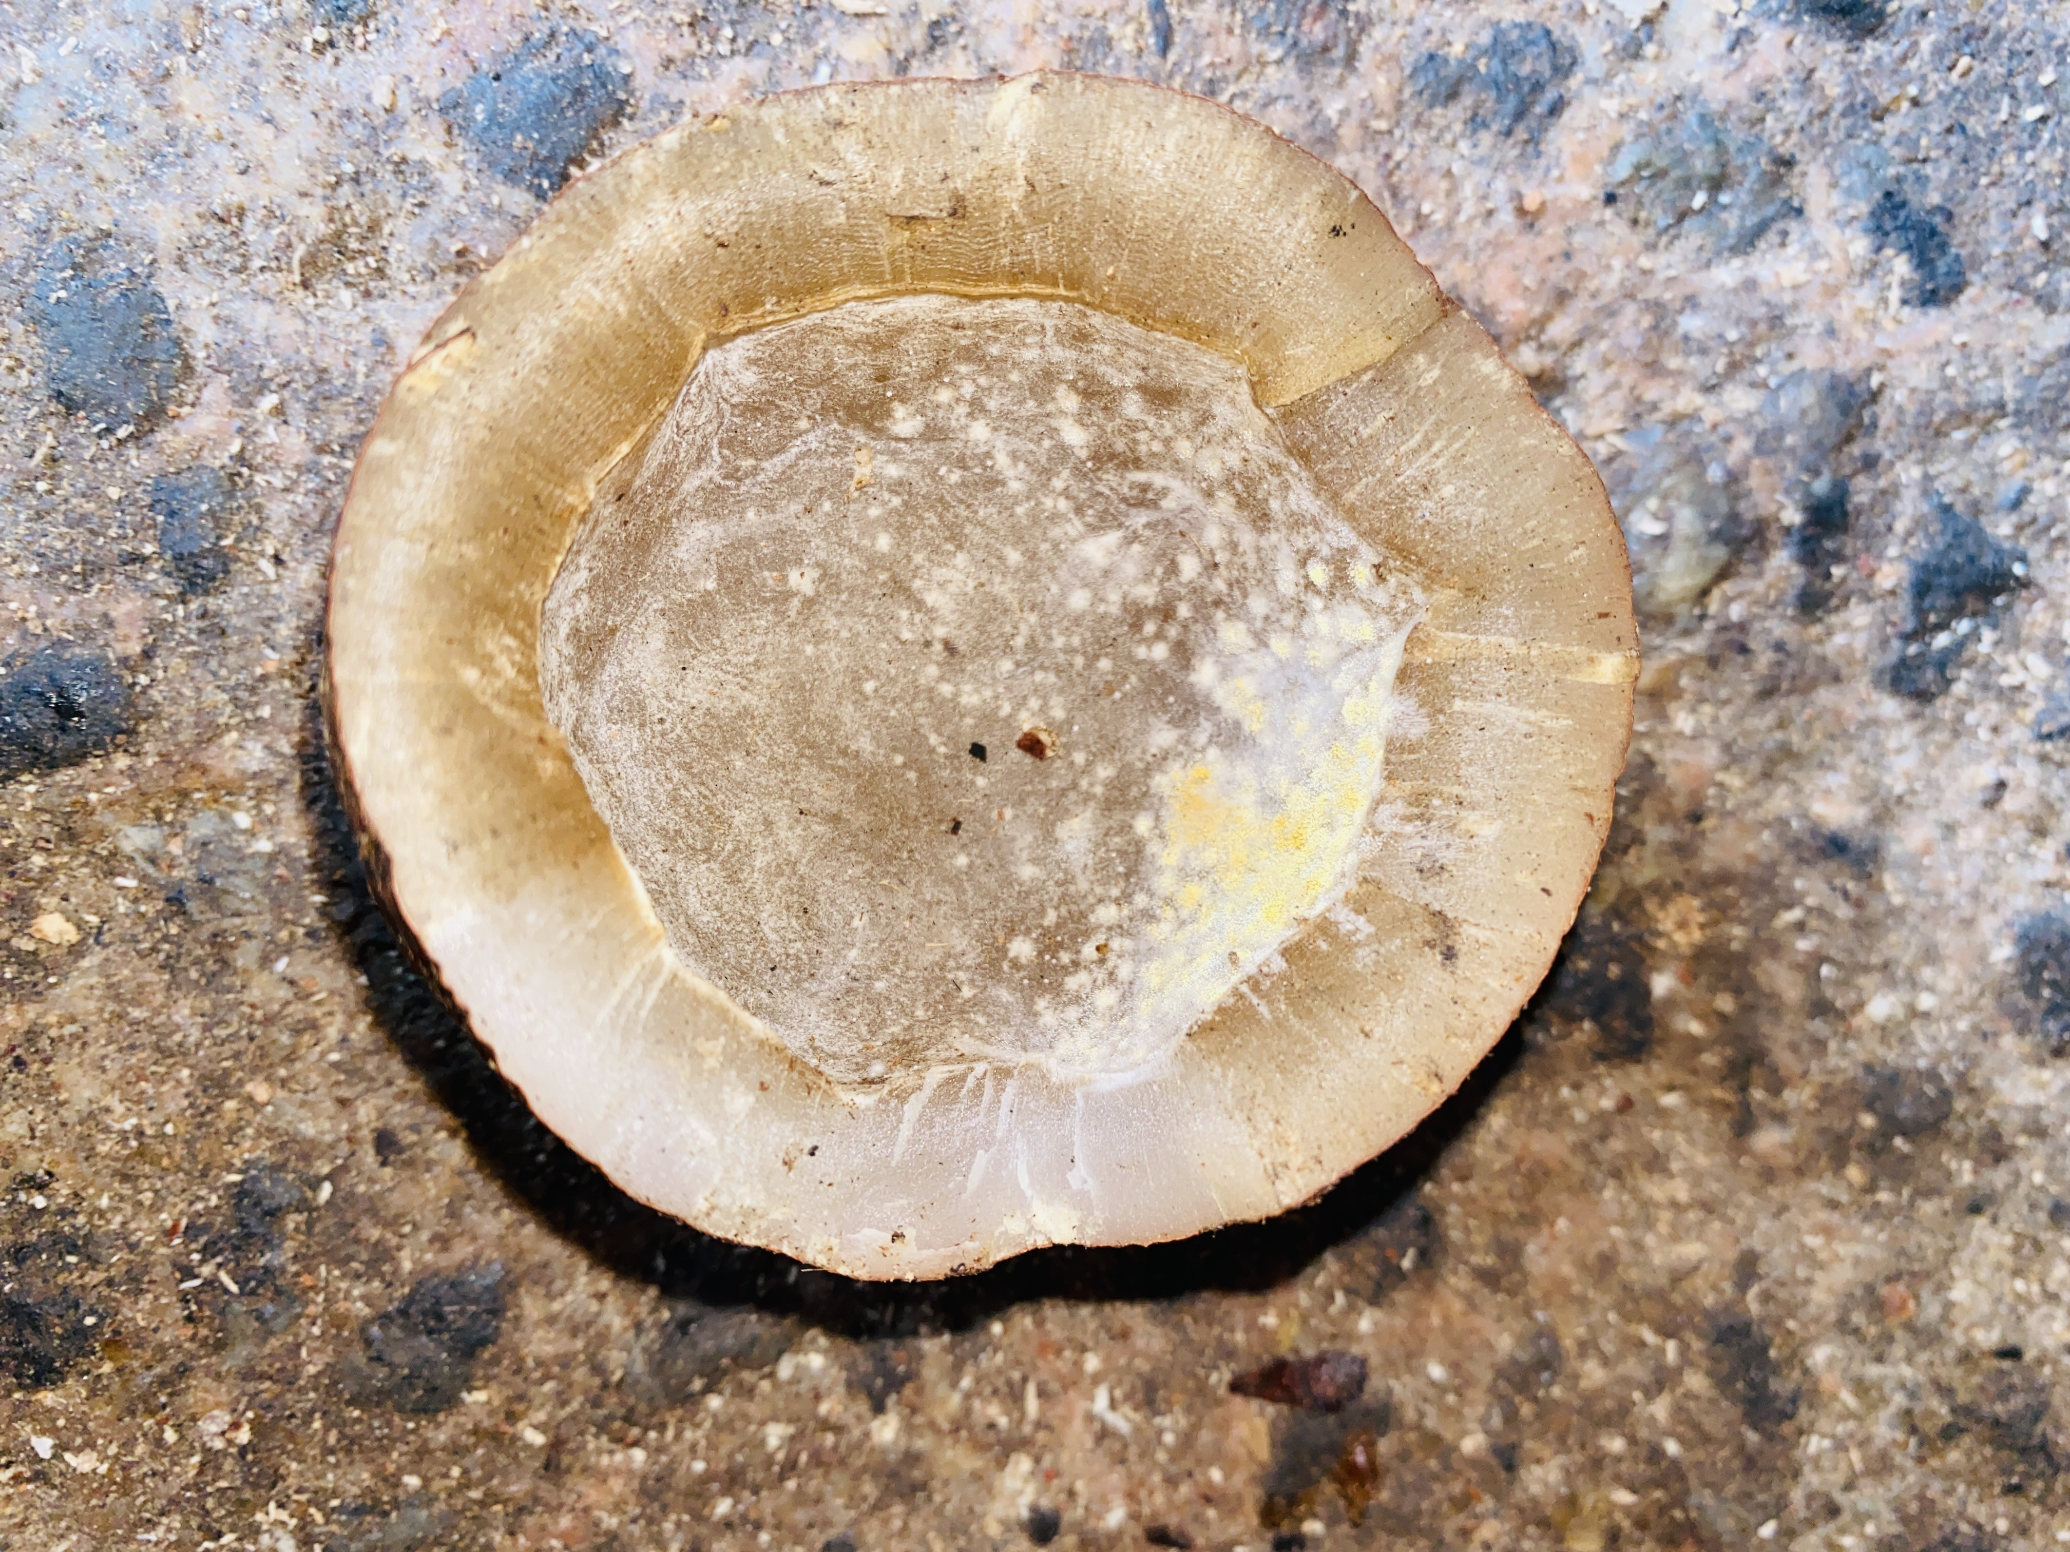
Data Collection
[A]
[B]
[C]

Slide 22
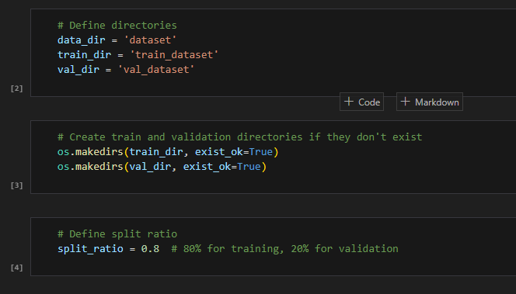
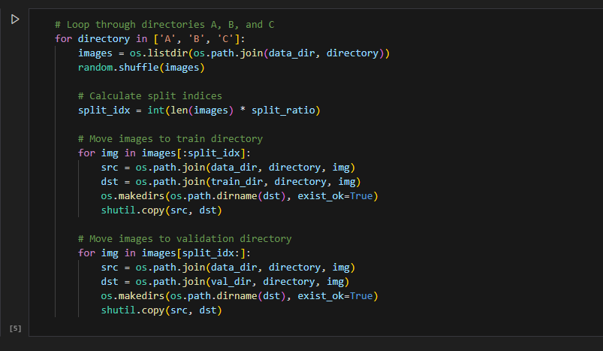
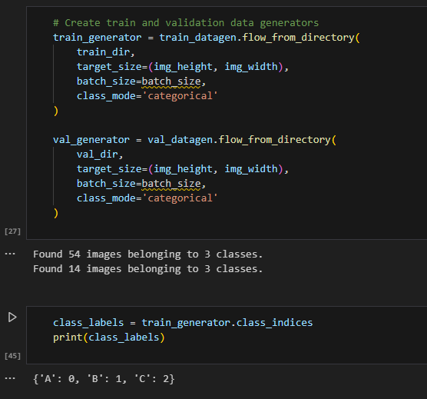
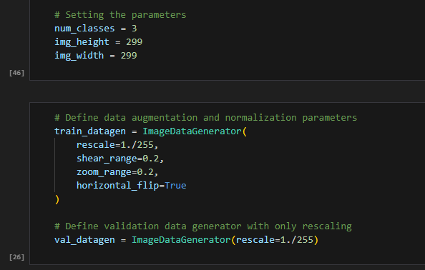
Data Pre-processing

Slide 23
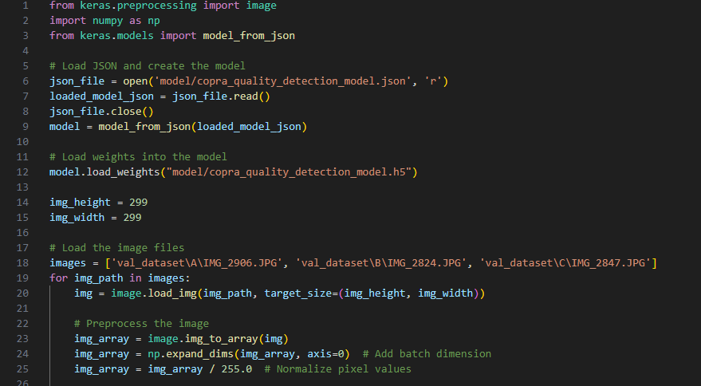
Data Pre-processing

Slide 24
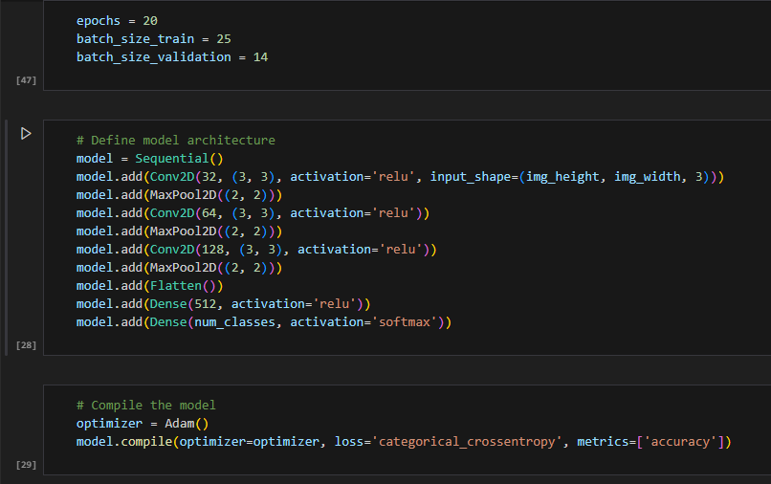
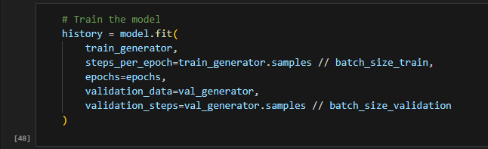
Train The Model

Slide 25
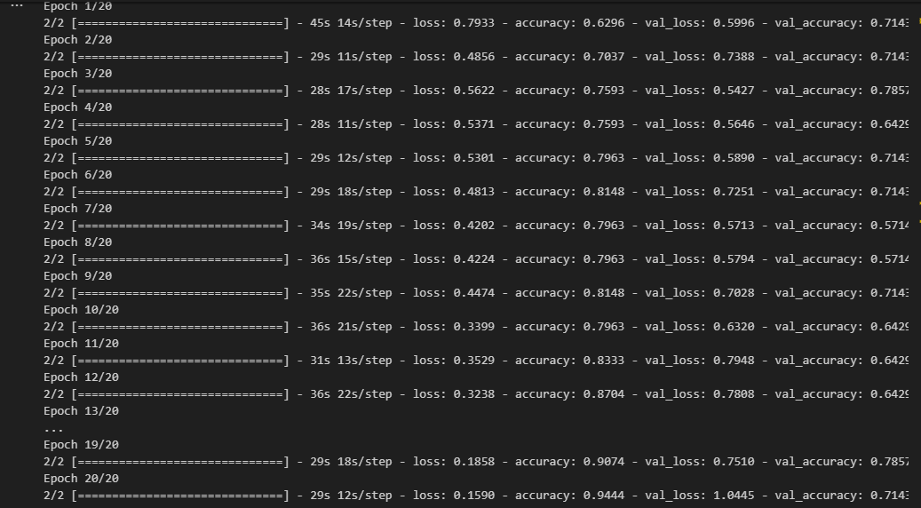
Accuracy
IT21061066 | WELIGAMA D.M.P.D | RP-059​

Slide 26
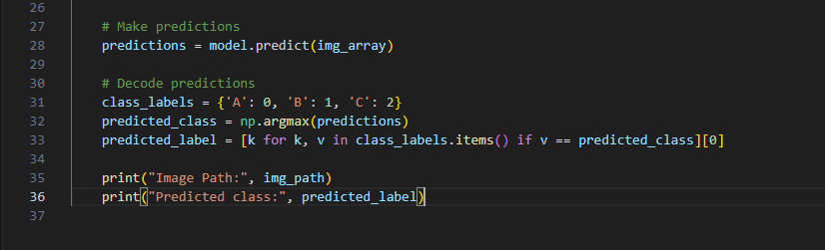
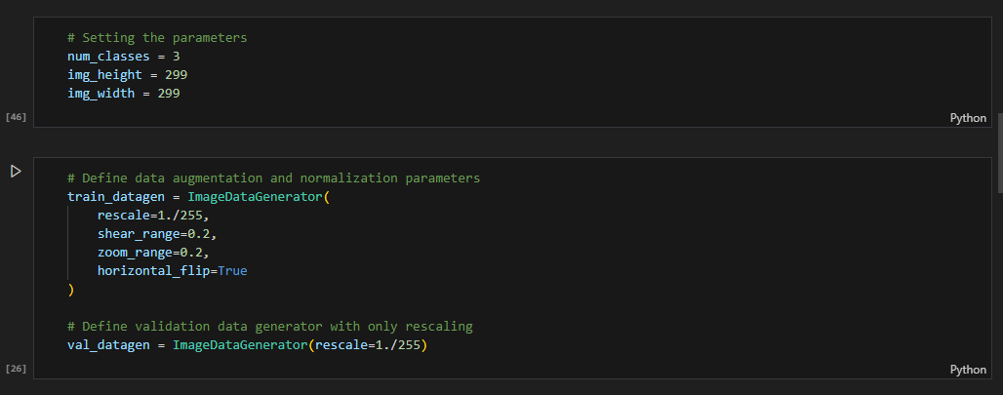
Prediction
IT21061066 | WELIGAMA D.M.P.D | RP-059​

Slide 27
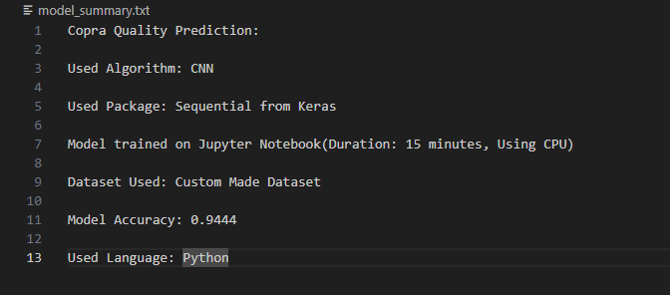
Model Summery
IT21061066 | WELIGAMA D.M.P.D | RP-059​

Slide 28
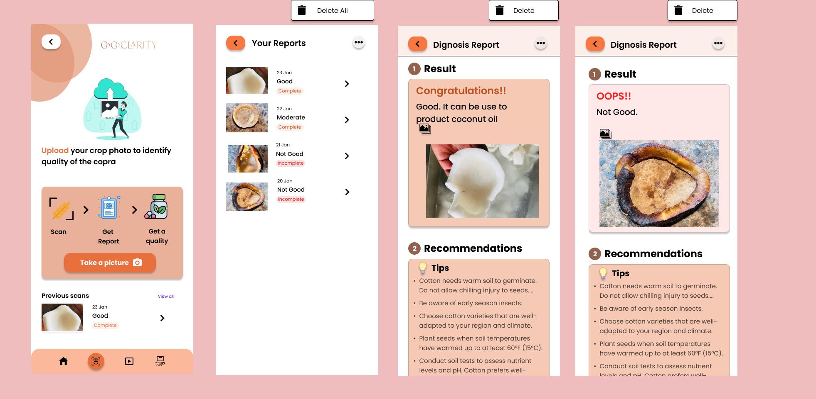
Designing UI for system
IT21061066 | WELIGAMA D.M.P.D | RP-059​

Slide 29
References
[1] W. Wongseree, N. Pongpullponsak, S. Kittibunchakul, N. Yoisungnern, and T. Bunrit, “Classifying coconut varieties using leaf images and deep convolutional neural networks,” Computers and Electronics in Agriculture, vol. 179, p. 105777, 2020.
[2] S. Palaniswami, L. J. Motha, A. Al Jabri, and H. R. Ghassemi, “Automatic detection and classification of coconut mites using digital image processing,” Computers and Electronics in Agriculture, vol. 175, p. 105564, 2020.
[3] M. Nejati, M. M. Paydara, and M. J. Darabi, “Using artificial intelligence to estimate coconut oil productions regarding effective parameters,” Industrial Crops and Products, vol. 154, p. 112763, 2020.
[4] G. K. Nair, B. Krishnan, S. N. Omkar, and T. Srinivas, “Coconut yield prediction using machine learning techniques,” Journal of Statistics and Management Systems, pp. 1–9, 2022.
[5] J. Lee, A. Krizhevsky, and I. Sutskever, “Using client feedback to continually improve image classification performance,” Communications of the ACM, vol. 64, no. 7, pp. 54–61, 2021.
IT21061066 | WELIGAMA D.M.P.D | RP-059

Slide 30
IT21020308 | DEWMINI A.M
IT Specialization
Oil Product Yield Estimator
IT21020308 | DEWMINI A.M. | RP-059
7/24/2024 19

Slide 31
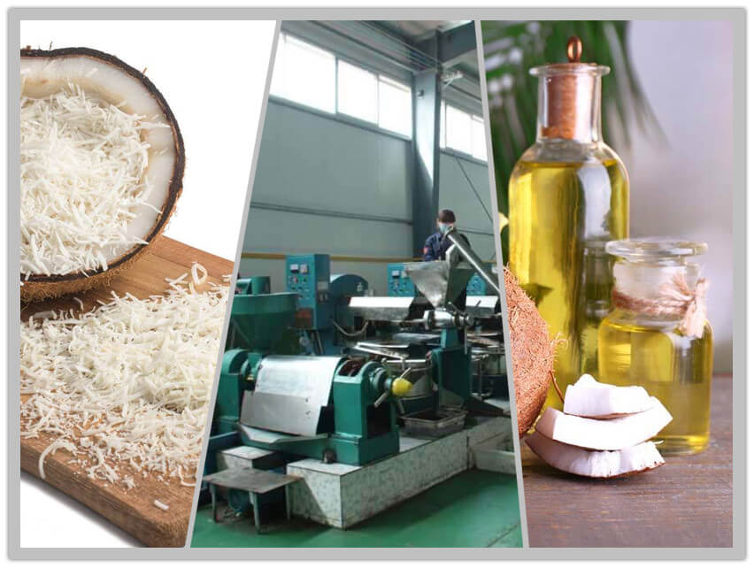
Background of the Study
Coconut oil production's impact on economic growth and exports
coconut oil production trends is crucial for policymakers and industry stakeholders to make informed decisions about resource allocation, trade policies, and economic planning.
Disruptions in production planning and capacity utilization due to fluctuating coconut yields
Coconut yields can be affected by various factors such as weather condition and diseases, leading to fluctuations in production levels.
IT21020308 | DEWMINI A.M. | RP-059

Slide 32

RESEARCH PROBLEM
Inconsistent Yield Prediction
Limited Integration of Weather conditions Insights
Underutilization of Advanced Predictive Analytics
Insufficient Focus on Sustainability
IT21020308 | DEWMINI A.M. | RP-059
7/24/2024

Slide 33
Research Gap of the Study
Insufficient Integration of Advanced Technologies
Inadequate Utilization of Historical Data
Impact of Inaccurate Predictions on Operational Efficiency
Need for a Sustainable and Profitable Approach
Opportunities for Improvement in Decision-Making
IT21020308 | DEWMINI A.M. | RP-059

Slide 34

Objectives of the Study
MAIN OBJECTIVES
To develop an intelligent system for accurate forecasting of coconut oil yield using advanced machine learning algorithms
SUB OBJECTIVES
Analyze historical yields data
Incorporate external influencing factors
Continuous model optimization for precision
User friendly dashboards for growers
IT21020308 | DEWMINI A.M. | RP-059

Slide 35

NOVELTY
Linking granular coconut profiles to past outputs
Adaptive learning mechanisms unique to region
Automated, tailored recommendations
IT21020308 | DEWMINI A.M. | RP-059

Slide 36
METHODOLOGY
Data Collection
Data Visualization
Data pre-processing
Host the finalized model in the flask server
Data augmentation and the best technique to retrain models to aselectedchieve good
Displayed the results in mobile application
IT21020308 | DEWMINI A.M. | RP-059

Slide 37
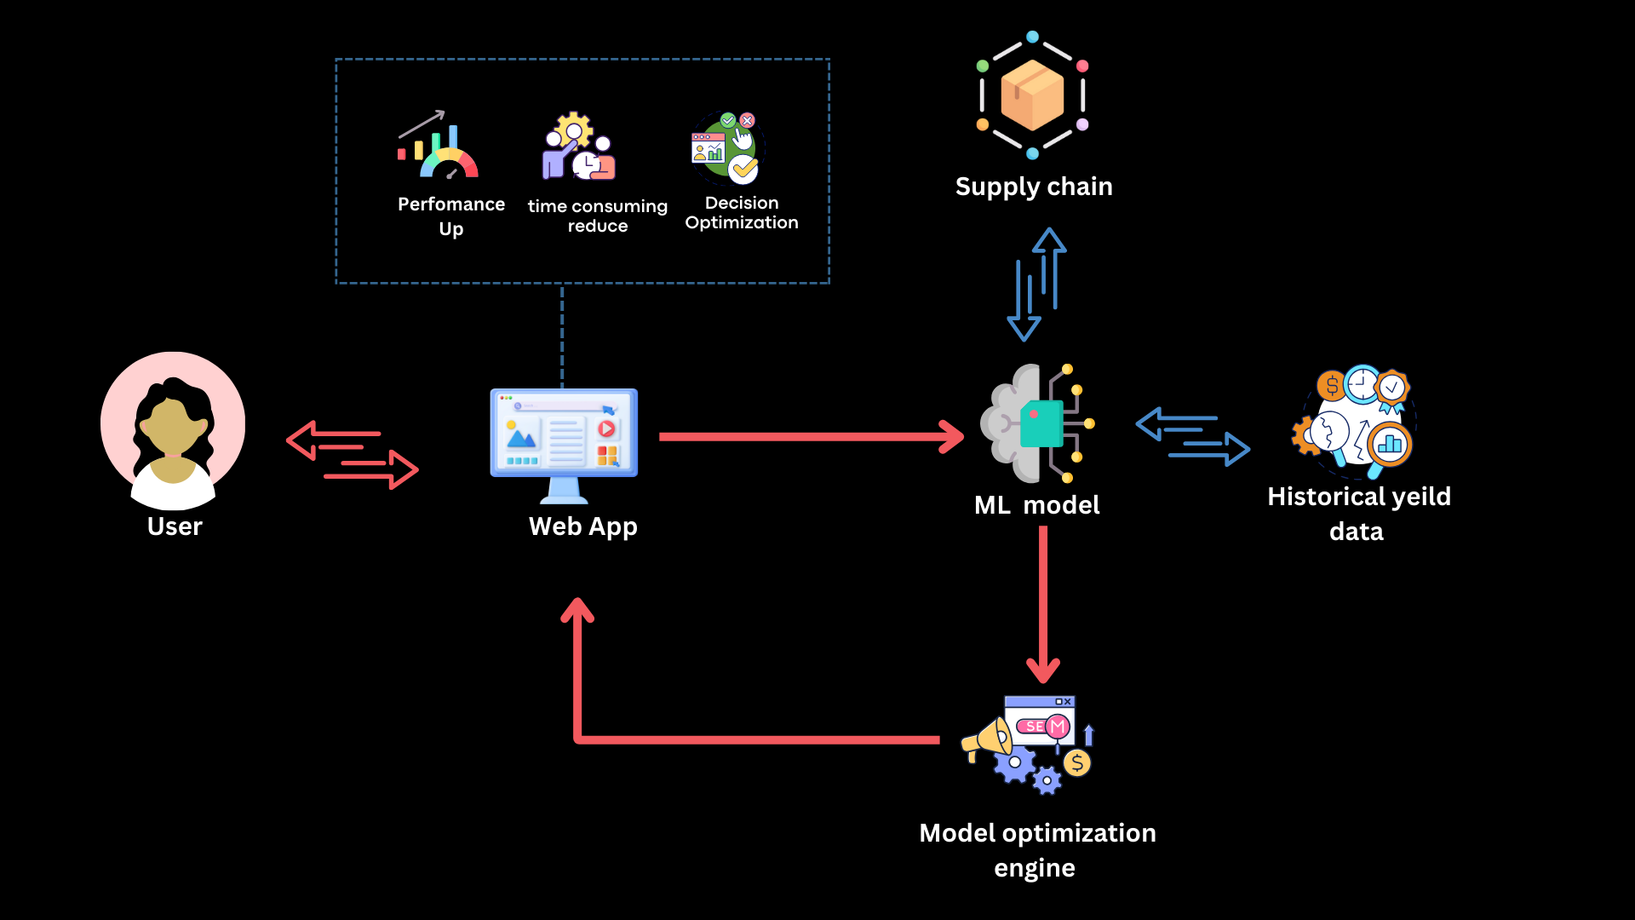

COMPONENT DIAGRAM
Weather condition
Mobile App
IT21020308 | DEWMINI A.M. | RP-059

Slide 38
Completion of the project
Find the historical data set for coconut oil production
Find the historical data set for weather conditions (Temperature/Rainfall/Wind speed)
Designing an UI for System
Combined and Train the model(neural network model) for predict forecast oil production
Train the model for predict forecast oil production
Implement of the backend
Implement of the backend
Implement of the frontend
Completed Works
Future Works
50%
IT21020308 | DEWMINI A.M. | RP-059

Slide 39
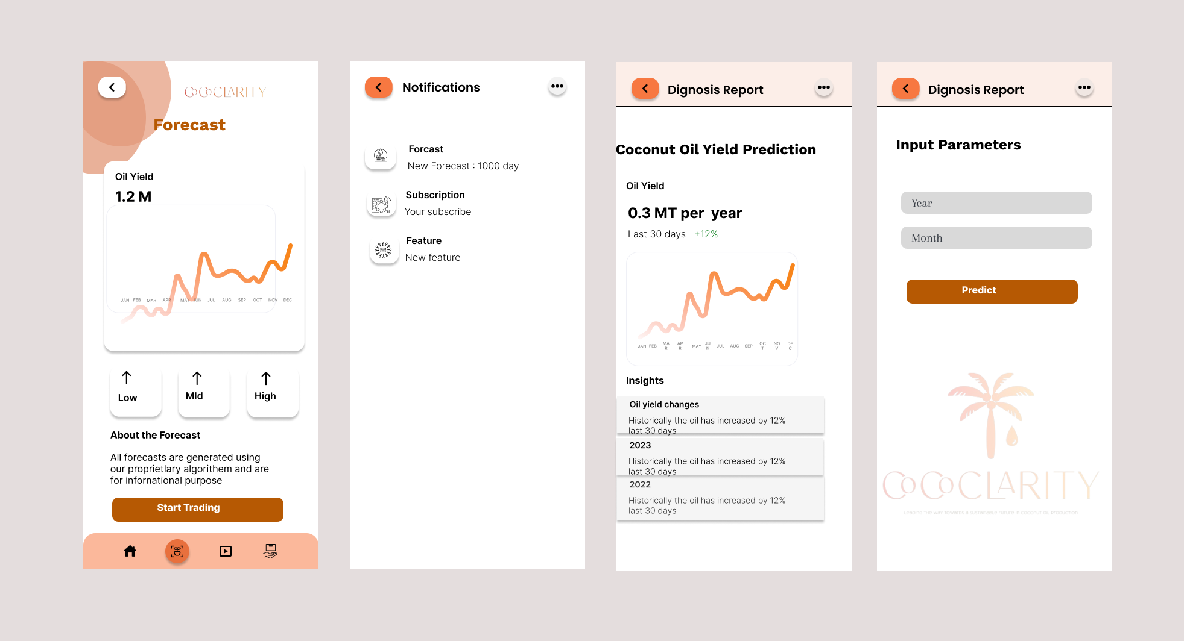
Designing UI for system
IT21020308 | DEWMINI A.M. | RP-059

Slide 40
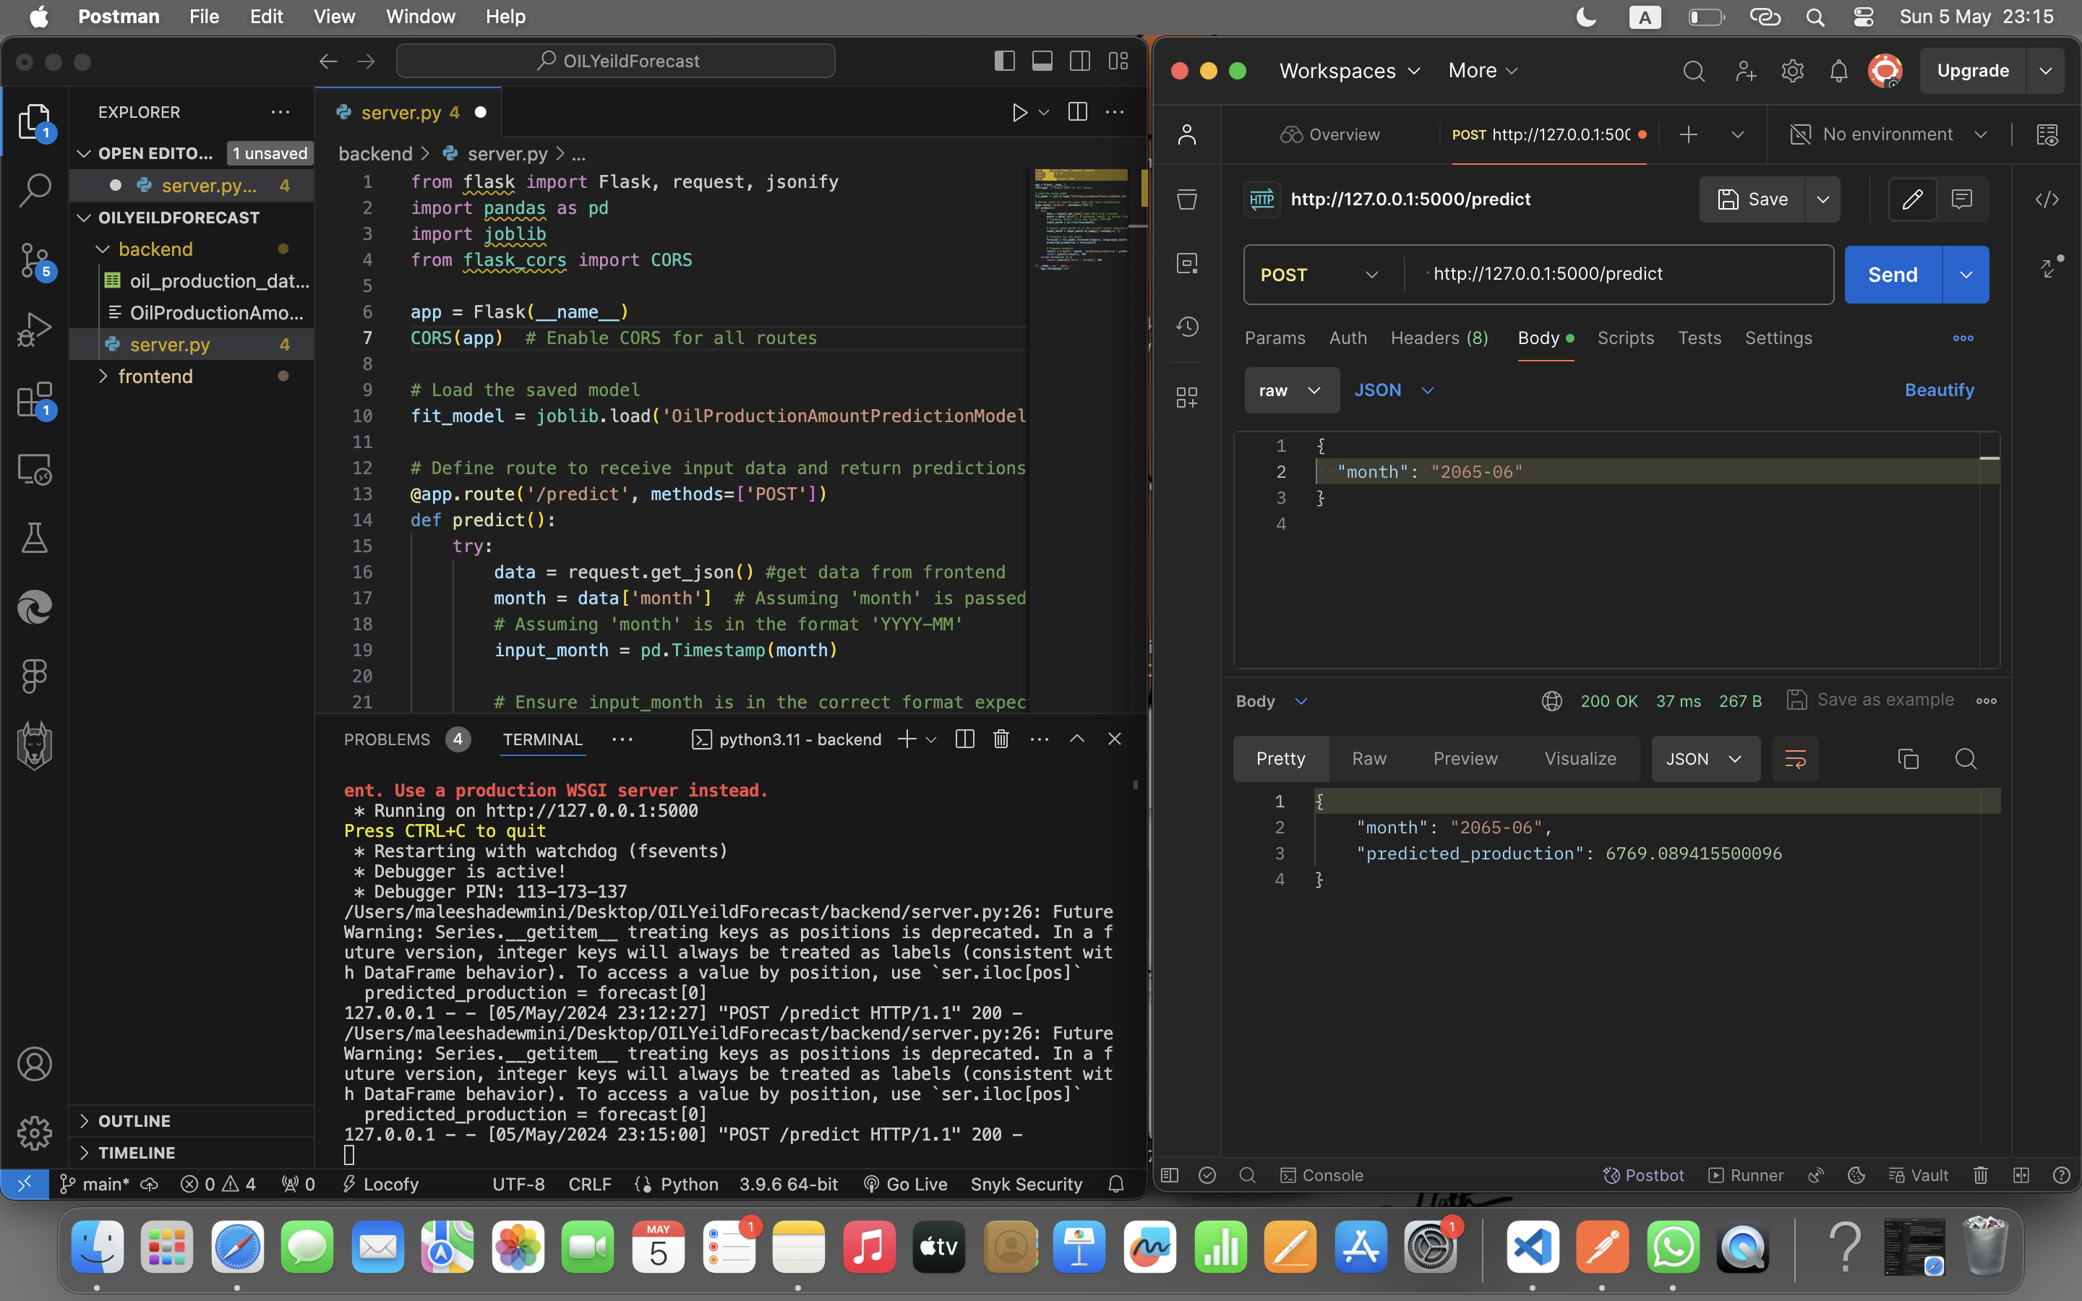
Implement Backend
IT21020308 | DEWMINI A.M. | RP-059

Slide 41
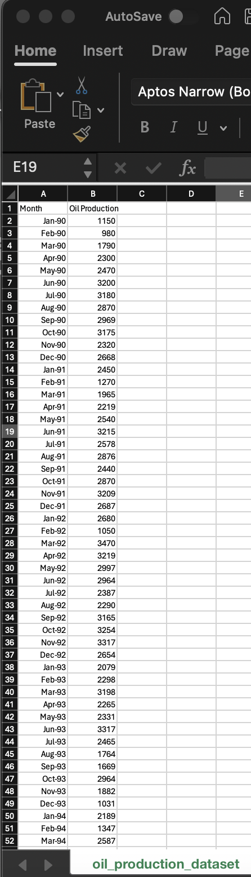
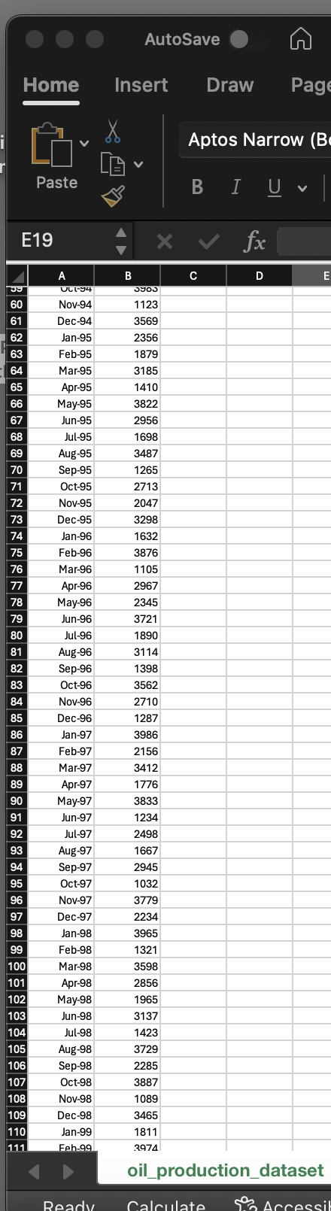
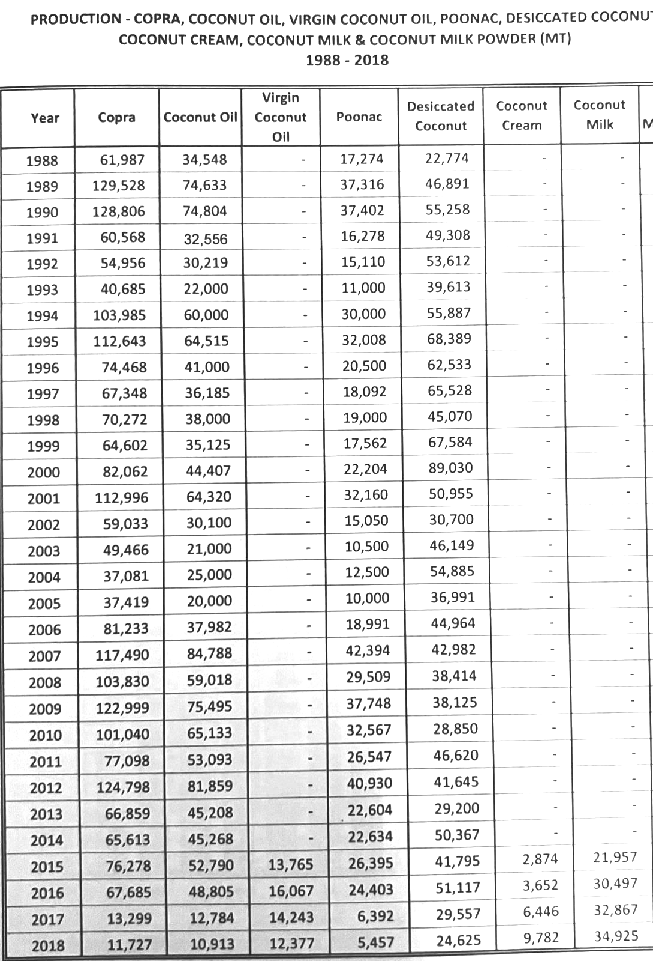
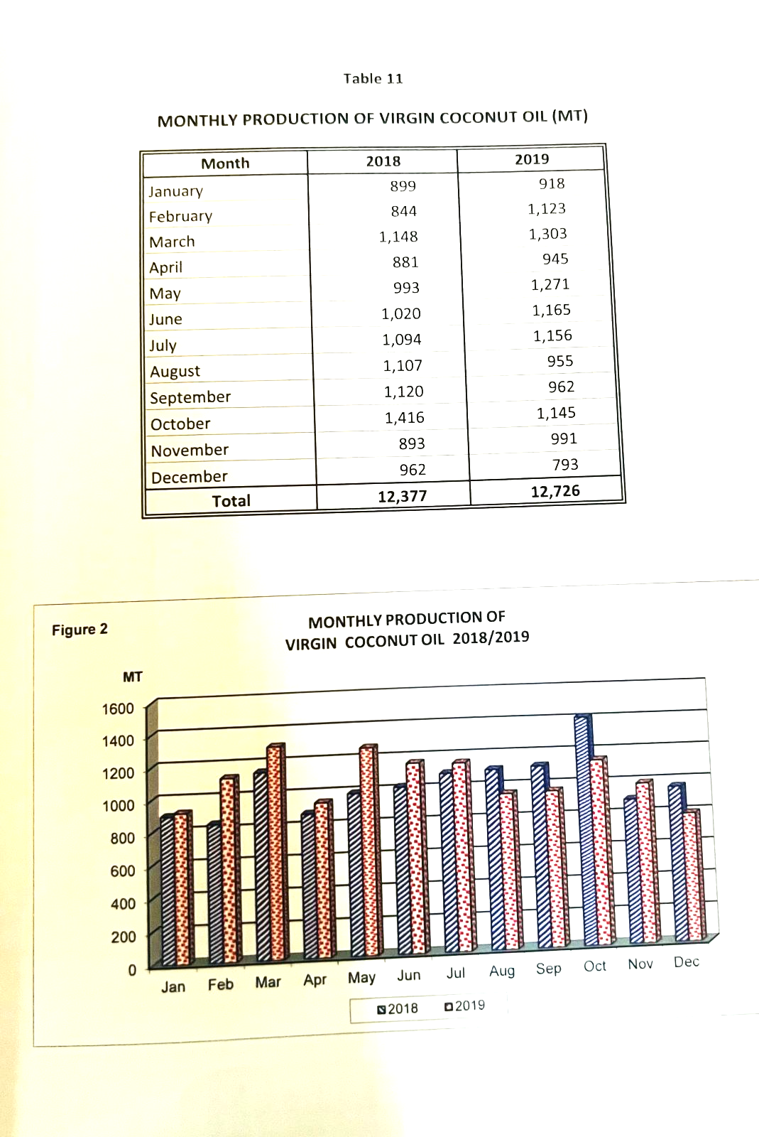
Completion of project
Oil yeald of 35 years in each months
Features – 2 (Month/Production)
Record – 400+
IT21020308 | DEWMINI A.M. | RP-059

Slide 42









Completion of project
Import libraries
Preprocess Data Format
Plot Original Data
Grid Search optimal parameters
Fit ARIMA Model
Forecast & Evaluate Accuracy
Forecast Long term
Plot Forecast Data
Plot Forecast + Original Data
IT21020308 | DEWMINI A.M. | RP-059

Slide 43
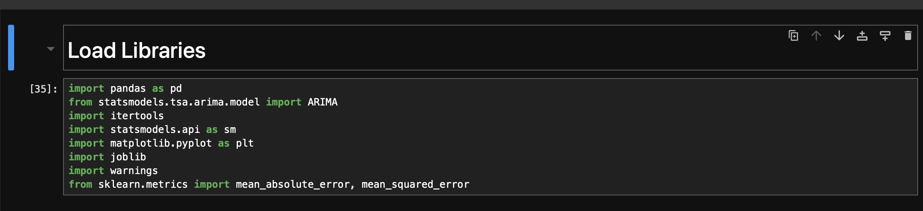
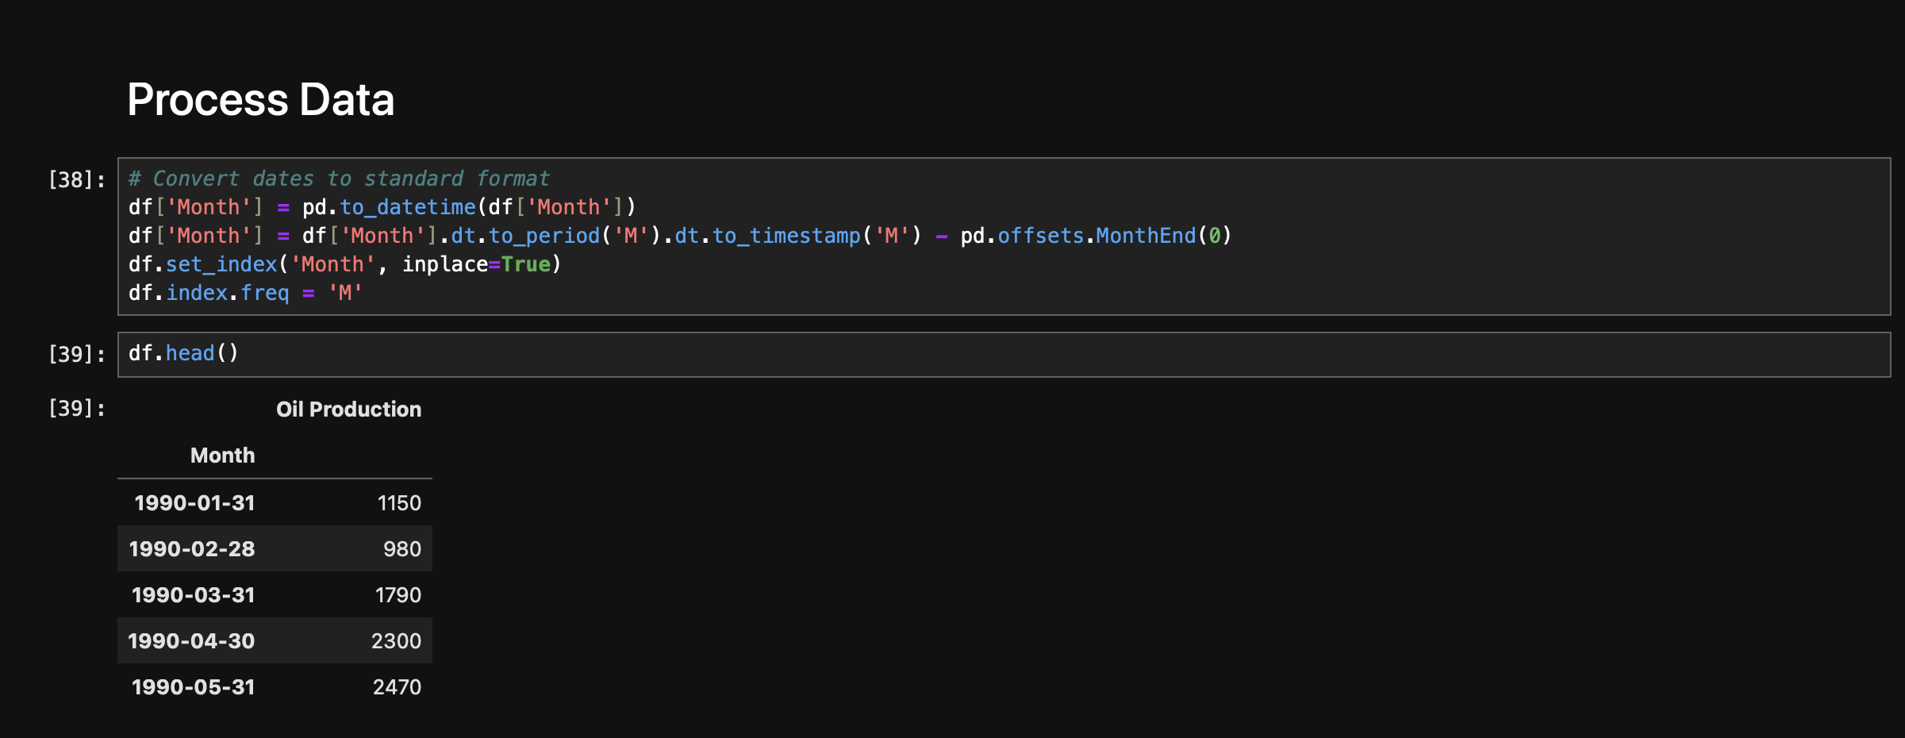
Data Collection and Pre-processing
Import necessary libraries for ARIMA modeling, data manipulation, and evaluation.
Convert date column to standard format and set it as index with monthly frequency.
IT21020308 | DEWMINI A.M. | RP-059

Slide 44
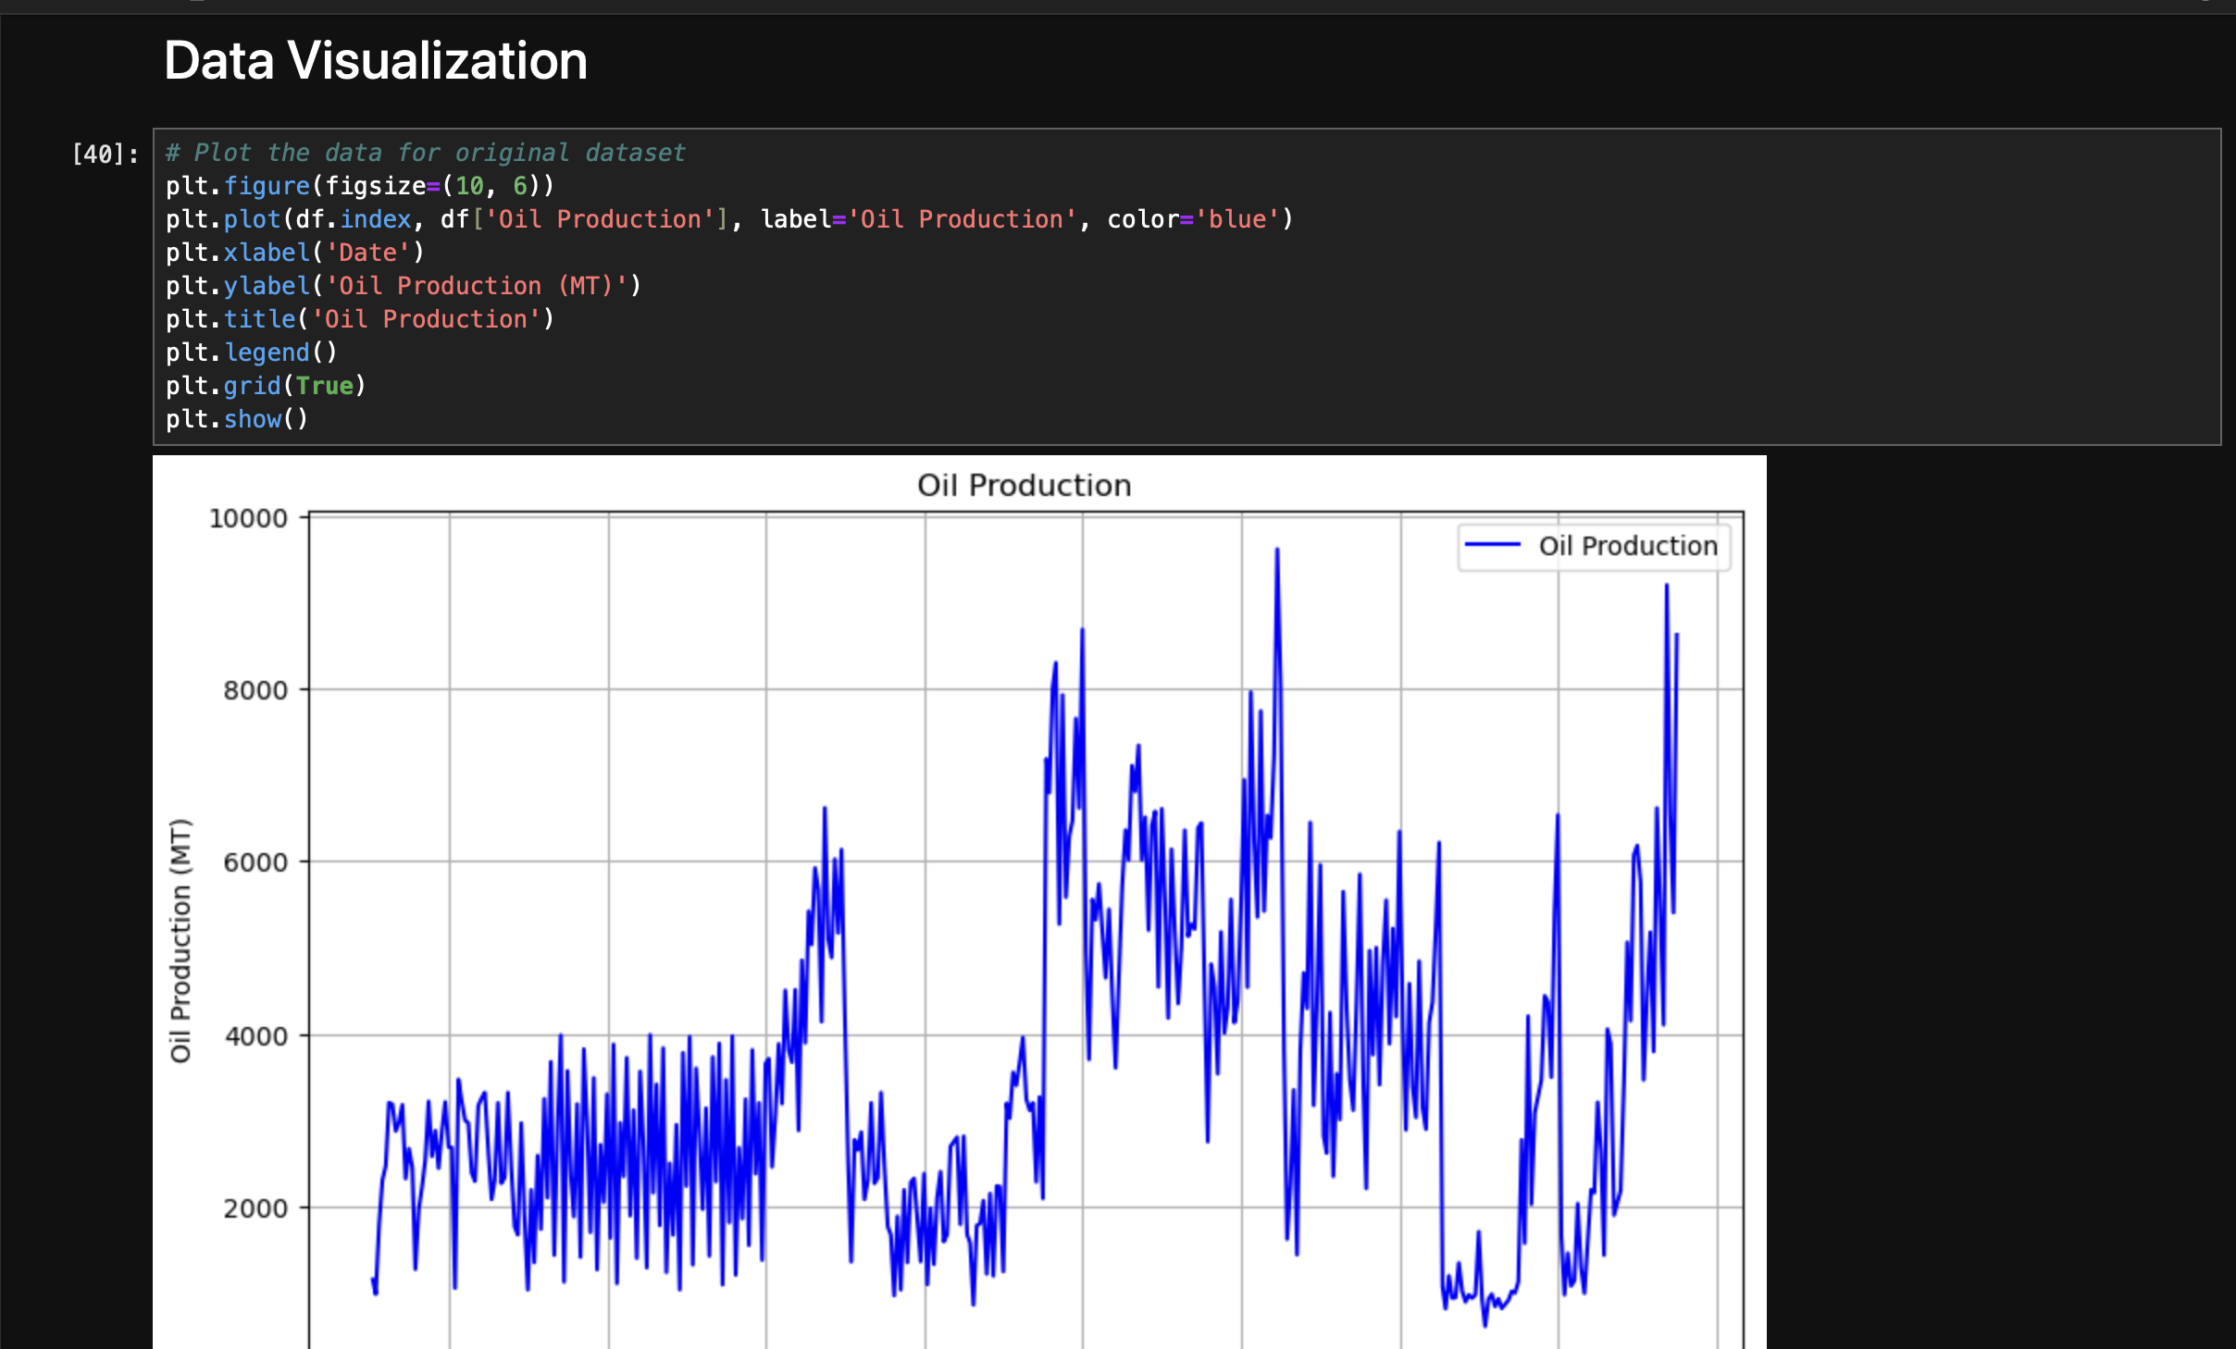
Original data visualization
Convert date column to standard format and set it as index with monthly frequency.
IT21020308 | DEWMINI A.M. | RP-059

Slide 45
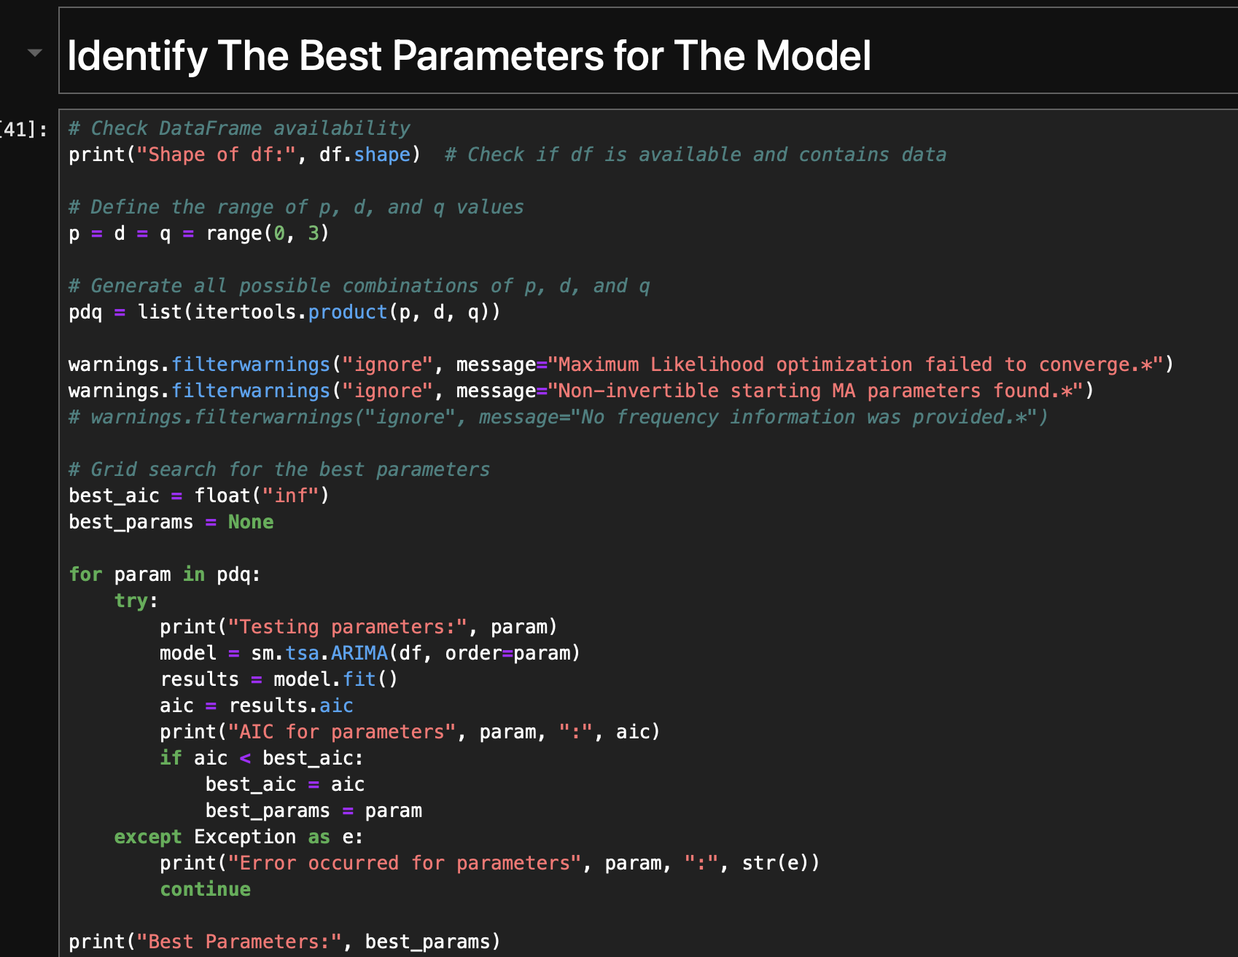
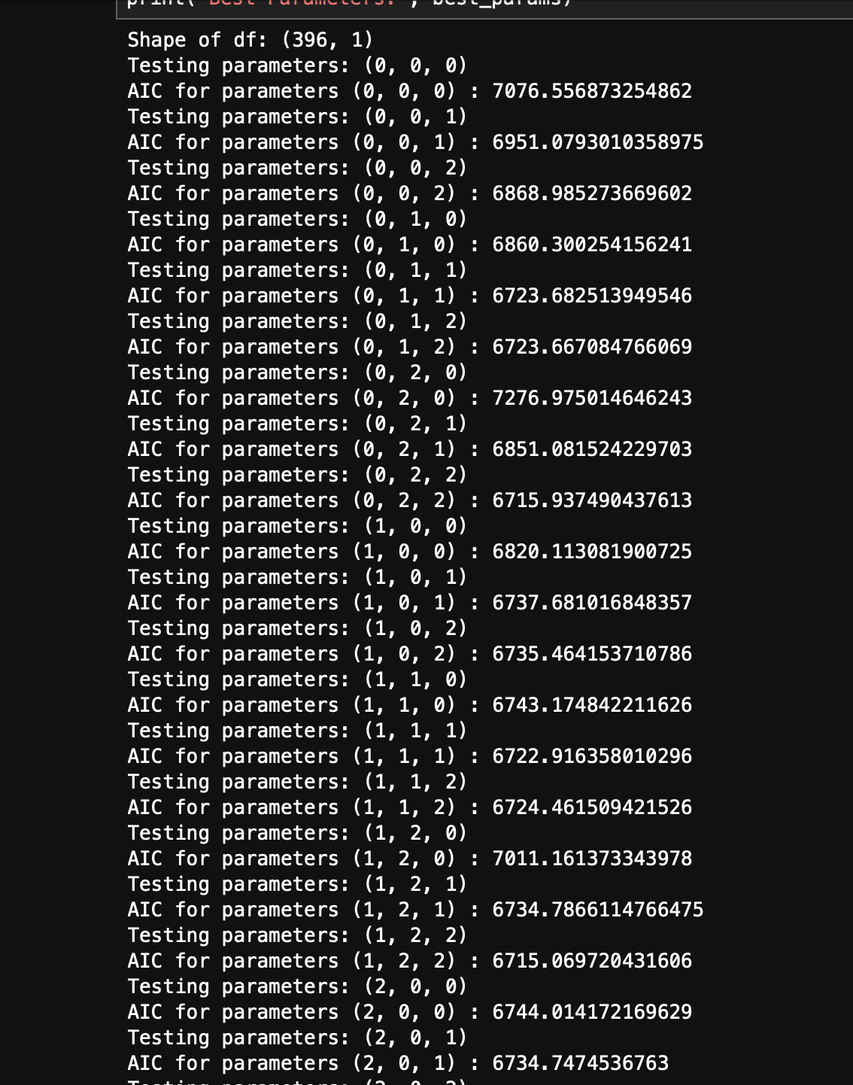
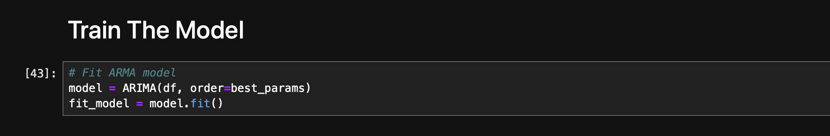
Train The Model
Perform grid search to find best ARIMA model parameters (p, d, q) based on AIC(Akaike Information Criterion).
Fit the ARIMA model with the best parameters found.
IT21020308 | DEWMINI A.M. | RP-059

Slide 46
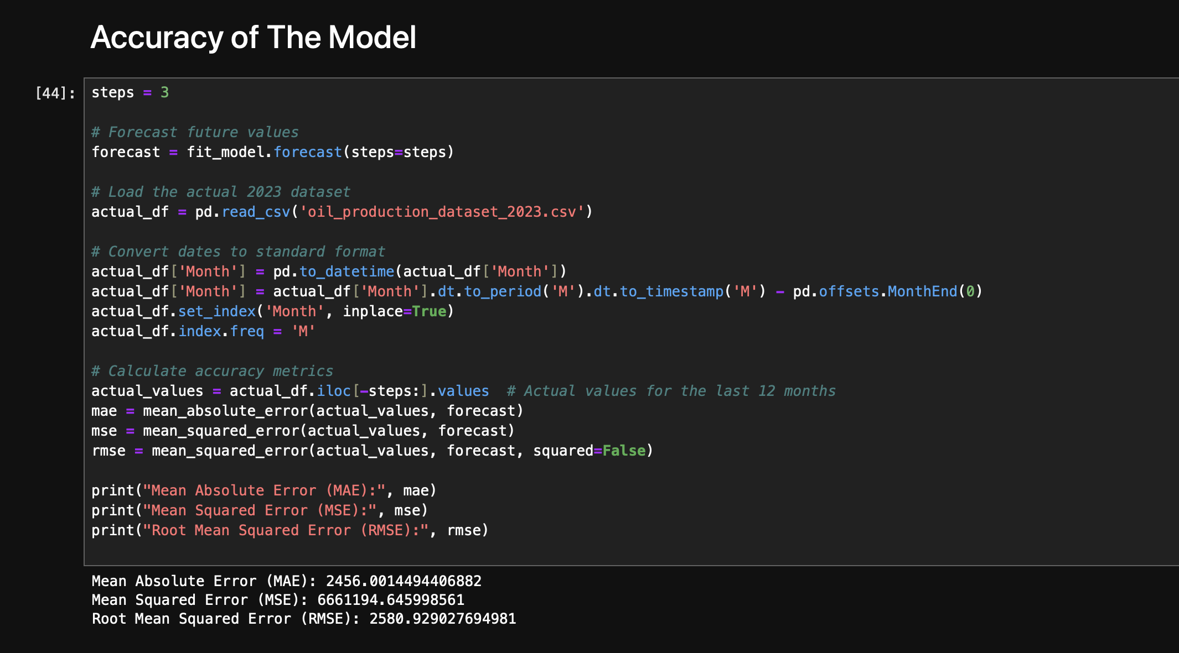
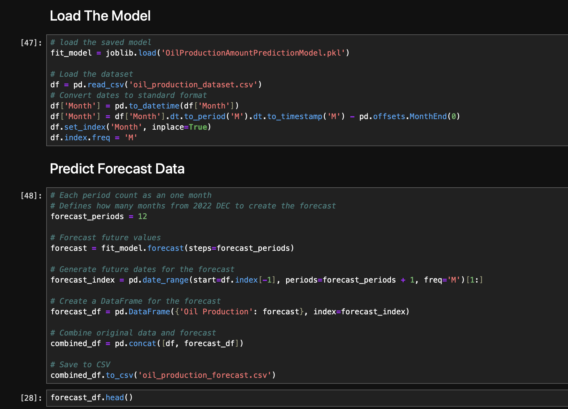
Accuracy & Predict forecast
Forecast oil production for the next 3 months, calculate accuracy metrics against actual 2023 data.
Forecast oil production for the next 12 months, combine original and forecasted data, save to CSV.
IT21020308 | DEWMINI A.M. | RP-059

Slide 47
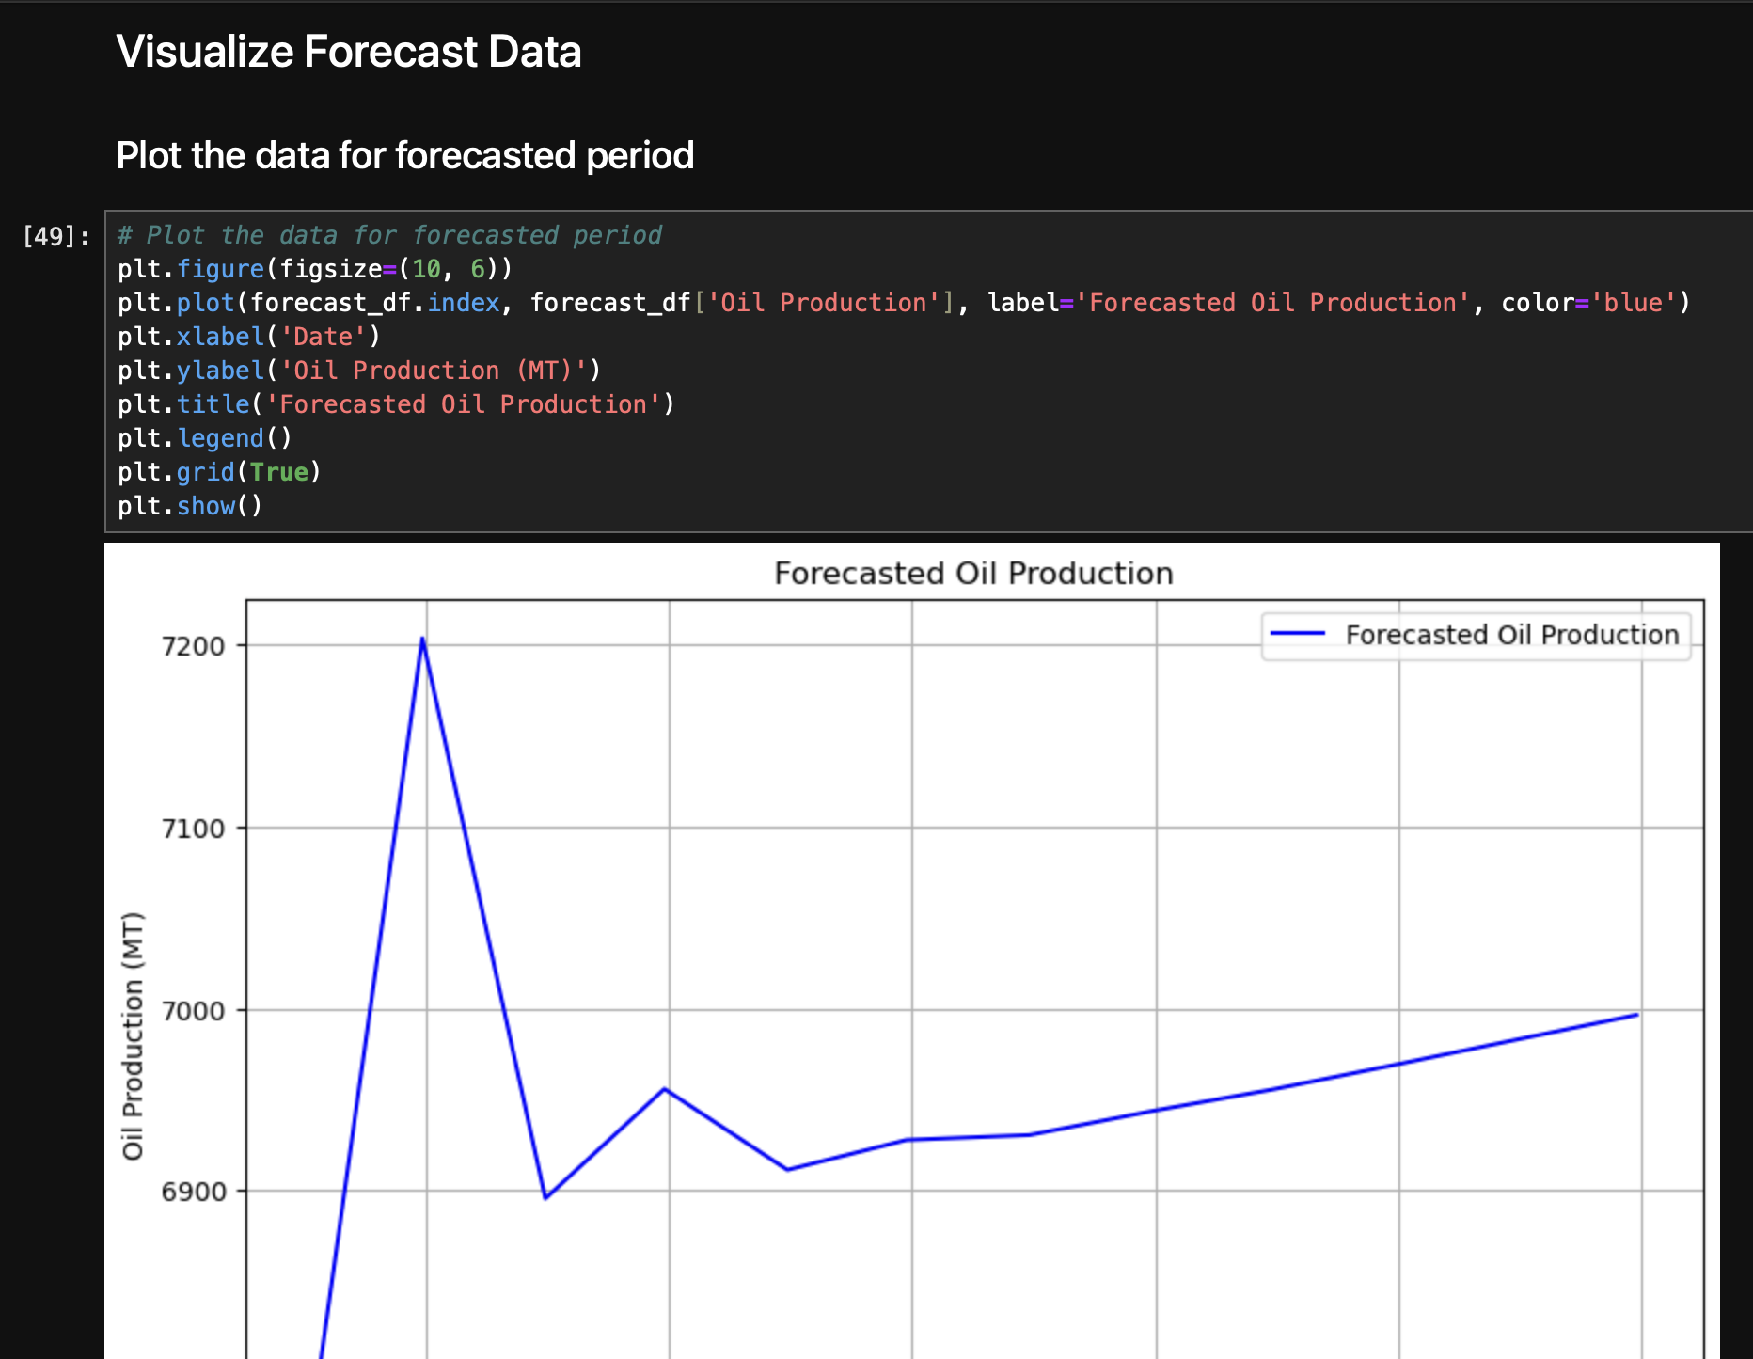
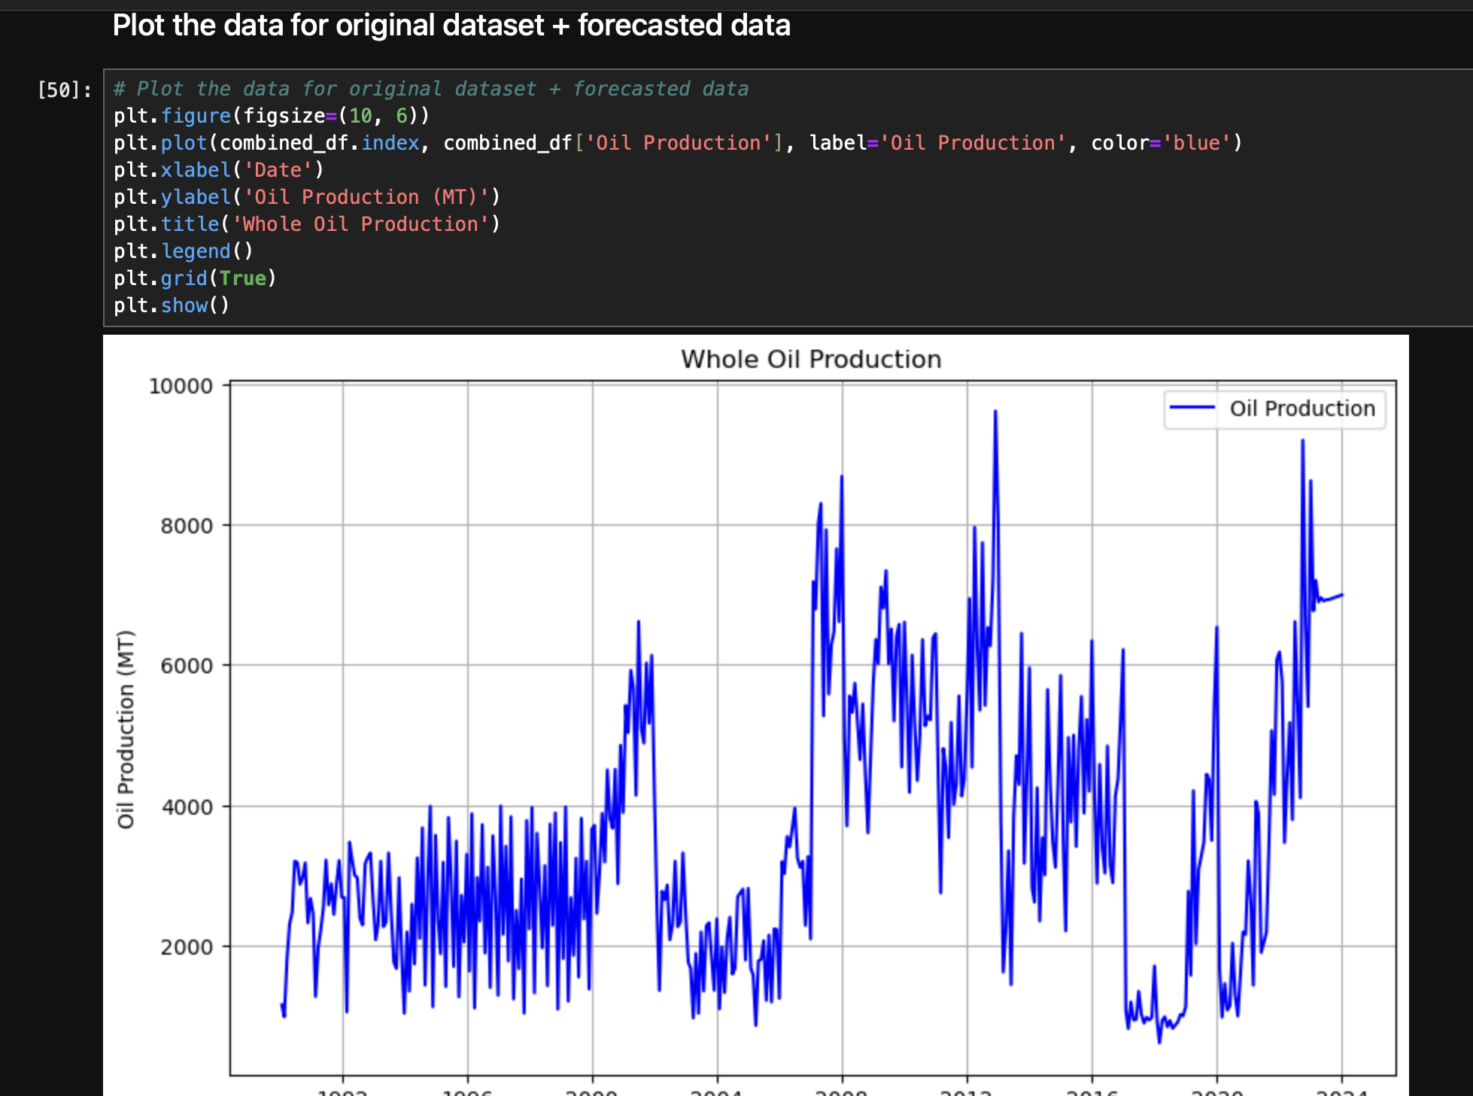
Visualize Forecast Data
Plot the forecasted oil production data over time.
Plot the combined original and forecasted oil production data over time.
IT21020308 | DEWMINI A.M. | RP-059

Slide 48
References
[1] J. Smith, A. Johnson, and B. Williams, “Traditional forecasting methods for agricultural yield prediction,” IEEE Transactions on Sustainable Agriculture, vol. 1, no. 2, pp. 76-89, (2019)
[2] S. Lee and J. Park, “Crop cultivation data analytics for precision agriculture,” IEEE Internet of Things Journal, vol. 8, no. 11, pp. 12387–12394, (2021)
[3 ] M. Rodriguez, G. Bondi, and G. Mangano, “Economic optimization of agricultural processes,” IEEE Robotics and Automation Letters, vol. 5, no. 2, pp. 3019-3026, (2020)
[4] J. Costa, M. Matte, and G. Reinehr, “Applications of AI in agriculture: A survey,” IEEE Access, vol. 6, pp. 78221-78245, (2018)
[5] M. Ahmed, J. S. Srai, and M. Hussain, “Blockchain for transparent and efficient agri-food supply chains,” IEEE Transactions on Engineering Management, vol. 69, no. 4, pp. 1465-1475, (2022)
IT21020308 | DEWMINI A.M. | RP-059

Slide 49
IT21103322| Bandara A.M.S.S
IT Specialization
Live Coconut oil Quality Measuring Feature
IT21103322 | Bandara A.M.S.S | RP-059
7/24/2024 29

Slide 50
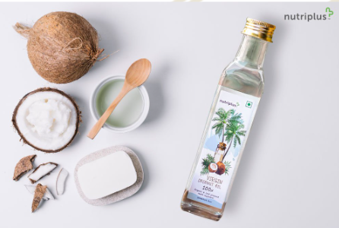
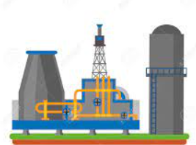
Background of the Study
Coconut Oil Industry Challenges
Traditional quality assessment methods in the coconut oil industry often rely on time-consuming and resource-intensive laboratory tests
Lack of real-time quality monitoring hinders prompt decision-making in production processes.
Objective
Develop a cutting-edge machine learning model to predict coconut oil quality using camera images, integrating image analysis and CNN algorithms.
IT21103322| Bandara A.M.S.S | RP-059

Slide 51
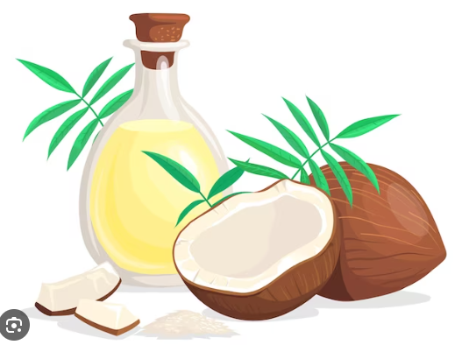
Background of the Study
Key Benefits
Real-time coconut oil quality assessment
Industry-relevant advancements in quality control.
IT21061066 | Bandara A.M.S.S | RP-059
7/24/2024

Slide 52

RESEARCH PROBLEM
Time-Consuming: Laboratory testing is slow, hindering timely decision-making ?
Lack of Real-time Monitoring: Existing methods lack the ability to provide real-time quality assessment ?
Costly and Resource-Intensive: Traditional testing methods can be resource-intensive, impacting production costs ?
IT21061066 | Bandara A.M.S.S | RP-059
7/24/2024

Slide 53

Objectives of the Study
Current research primarily relies on traditional laboratory tests for assessing coconut oil quality.
Develop a Machine Learning Model to predict the quality of coconut oil.
Compare Predictions with Laboratory Results.
Build a Real-time Quality Assessment Tool(Mobile app).
IT21061066 | Bandara A.M.S.S | RP-059
7/24/2024

Slide 54
METHODOLOGY
1.Data Collection
-Lab report data/ coconut oil images
6.Comparison with Laboratory Results-
compare model predictions with laboratory results to validate the accuracy and reliability of the model
2.Data preprocessing
7.Mobile App Development
-Integrate the trained model in to app for on-device prediction
3.Feature Extraction
4.Model Selection
5.Model training

Slide 55
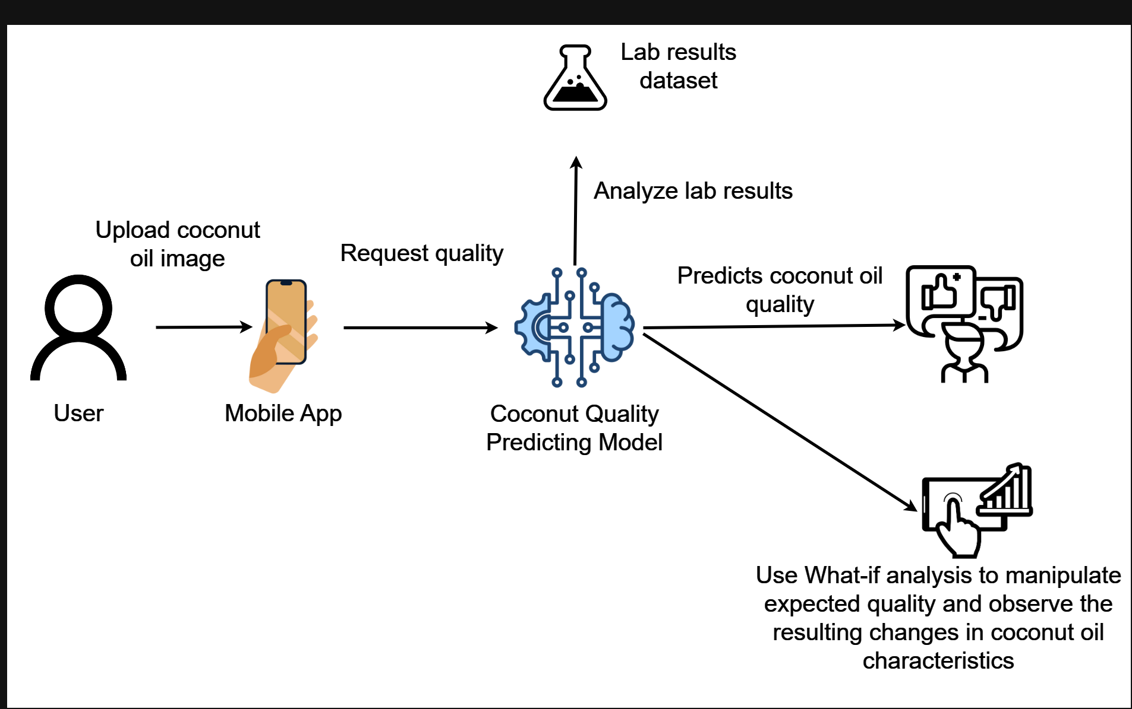

COMPONENT DIAGRAM
Generate reports
IT21061066 | Bandara A.M.S.S | RP-059
7/24/2024

Slide 56
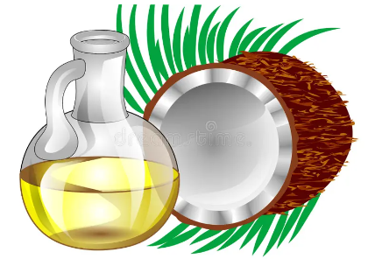

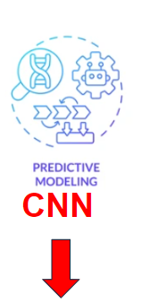





NOVELTY
An image of coconut oil is taken with a mobile phone camera and the information is compared with the data collected in the previous laboratory test and link been created display the coconut oil quality more accurately.
IT21061066 | Bandara A.M.S.S | RP-059

Slide 57


Completion of the project
Data Collection
Data preprocessing
Feature Extractions
Model Selection
Model training

Slide 58



Data Collection​
Coconut oil samples- SLS

Slide 59


Data preprocessing ​
Clean and preprocess the sample data. (Resizing, normalization, and handling any missing or noisy data)
Split the dataset into training and testing sets.

Slide 60


Feature Extractions
Extract relevant features from the coconut samples quality analyse data sets .
It helps to contribute to predicting the quality of coconut oil.

Slide 61



Model Selection
Model Selection
Used Algorithm: Decision Tree Classifier

Slide 62





Model training
Train the selected model using the training dataset using Decision Tree Classifier
Fine-tune hyperparameters to optimize the model's performance.

Slide 63

Accuracy & Predict

Slide 64
Future Works (-50%)
Collect coconut oil sample images
Develop ML module to predict the quality of coconut oil using sample images data set and CNN algorithm
Develop the user interface

Slide 65
References
[1]F. M. Dayrit, I. K. D. Dimzon, M. F. Valde, J. E. R. Santos, M. J. M. Garrovillas, and B. J. Villarino, "Quality characteristics of virgin coconut oil: Comparisons with refined coconut oil," Pure and Applied Chemistry, vol. 83, no. 9, pp. 1789–1799, Aug. 2011, doi: 10.1351/pac-con-11-04-01.
[2]A. Palananda and W. Kimpan, “Classification of Adulterated Particle Images in Coconut Oil Using Deep Learning Approaches,” Applied Sciences, vol. 12, no. 2, p. 656, Jan. 2022, doi: https://doi.org/10.3390/app12020656.
[3]A. Rohman, Y. Irnawati Erwanto, E. Lukitaningsih, M. Rafi, N. A. Fadzilah, A. Windarsih, A. Sulaiman, and Z. Zakaria, "Virgin Coconut Oil: Extraction, Physicochemical Properties, Biological Activities and Its Authentication Analysis," Food Rev Int., vol. 37, no. 1, pp. 46–66, 2021. Available at: http://doi.org/10.1080/87559129.2019.1687515.
[4]A. Palananda and W. Kimpan,"Turbidity of Coconut Oil Determination Using the MAMoH Method in Image Processing,"IEEE Access, vol. 9, pp. 41494-41505, 2021,doi: 10.1109/ACCESS.2021.3065004.
IT21061066 | Bandara A.M.S.S | RP-059

Slide 66
IT21078378 | Fernando W.P.A.M
SE Specialization
The Decentralized Demand and Supply Platform
IT21078378 | Fernando W.P.A.M | RP-059
7/24/2024 29

Slide 67

Background of the Study
When the economy changes,
How much coconut oil should be required by each country?
How much coconut oil should be produced?
What percentage should be distributed to each country each industry?
IT21078378 | Fernando W.P.A.M | RP-059

Slide 68

RESEARCH PROBLEM
Lack of a country-wise demand predicting system.
Lack of predicting the profitable countries to export in the future.
Lack of an industry distribution percentage predicting system.
IT21078378 | Fernando W.P.A.M | RP-059
7/24/2024

Slide 69


Research Gap of the Study
 | RESEARCH 1 | RESEARCH 2 | RESEARCH 3 | PROPOSED SOLUTION
Forecast required coconut oil yield based on economy status
Forecast coconut oil price based on countries economy status
Forecast how much of coconut oil should be produced to overcome inflation issues
Forecast percentages that should be distributed to different countries' sectors as the economy changes
Manipulate expected profit and observe the resulting changes in predicted coconut oil prices and distribution percentages
IT21078378 | Fernando W.P.A.M | RP-059

Slide 70
Objectives of the Study
MAIN OBJECTIVES
Develop a Predictive Model for Decentralized Demand and Supply
SUB OBJECTIVES
Study coconut oil export statistics in in Sri Lanka.
Visualize future uired coconut oil yield by country-wise.
Integrate price and distribution sector prediction model.
IT21078378 | Fernando W.P.A.M | RP-059
7/24/2024

Slide 71

NOVELTY
As the inflation changes, how much oil should countries need, and what amount should be exported to different countries, including What-If Analysis.
IT21078378 | Fernando W.P.A.M | RP-059

Slide 72


Slide 73

COMPONENT DIAGRAM
IT21078378 | Fernando W.P.A.M | RP-059

Slide 74

Step 1: Data Collection
Sri Lanka Coconut Oil export quantity dataset [2002-2022] years
in each year
Features – 5 (country/ year/ inflation / exported / num_of_exporters
Record – 2157
Source: CDA
IT21078378 | FERNANDO W.P.A.M. | RP-059

Slide 75

Step 1: Data Collection [contd]
Country-wise Coconut oil imported quantities
dataset [2002-2022] in each year
Features – 4 (country/year/ inflation/ imported)
Record – 2157 Source:
http://www.cepii.fr/CEPII/en/bdd_modele/bdd_modele_item.asp?id=37
IT21078378 | FERNANDO W.P.A.M. | RP-059

Slide 76

Step 1: Data Collection [contd]
Global inflation dataset [2002-2022] in each year
Features – 20 (country/year from 2002-2022
Record – 197
Source: https://www.kaggle.com/datasets/sazidthe1/global-inflation-data
IT21078378 | FERNANDO W.P.A.M. | RP-059

Slide 77

Completion of project
Step 2: Data Preprocessing
Merge imported dataset with inflation dataset.
Merge exported dataset with inflation dataset.
Remove the missing value columns
Calculating the number of exporters the country exported in that year
Calculating the CAGR (last 5 years import growth)
IT21078378 | FERNANDO W.P.A.M. | RP-059

Slide 78


Completion of project
Step 3: Choosing the right model
Apply Logistic Regression, Decision Tree and Random Forest.
More Accurate model will be chosen.
IT21078378 | FERNANDO W.P.A.M. | RP-059

Slide 79

Completion of project
Step 4: Training the model
Train the model and store it in a pickle file.
IT21078378 | FERNANDO W.P.A.M. | RP-059

Slide 80

Completion of project
Step 7: Predictions
Open the trained model from the pickle file and use it.
IT21078378 | FERNANDO W.P.A.M. | RP-059

Slide 81

Visualization of Original Dataset
IT21078378 | FERNANDO W.P.A.M. | RP-059

Slide 82
REQUIREMENTS
Functional Requirements
Predicting demand based on country and inflation.
Predicting export amount based on and.
Integrate What-if analysis.
Non-Functional Requirements
Accuracy of predicting data
Timeliness of information
Maintainability
IT21078378 | Fernando W.P.A.M | RP-059

Slide 83
References
[1] Abeysekara, M. G. D., and K.P Waidyarathne. “The Coconut Industry: A Review of Price Forecasting Modelling in Major Coconut Producing Countries.” CORD, vol. 36, 21 Nov. 2020, pp. 6–15, https://doi.org/10.37833/cord.v36i.422. Accessed 26 Aug. 2021.
[2] Priyanga, et al. “Forecasting Coconut Oil Price Using Auto Regressive Integrated Moving Average (ARIMA) Model.” Journal of Pharmacognosy and Phytochemistry, vol. 8, no. 3, 1 Jan. 2019, pp. 2164–2169. Accessed 19 Feb. 2024.
[3] “Refined Coconut Oil Prices: Latest Price, Historical & Forecast.” Www.procurementresource.com, www.procurementresource.com/resource-center/refined-coconut-oil-price-trends. Accessed 19 Feb. 2024.
IT21078378 | Fernando W.P.A.M | RP-059

Slide 84

TECHNOLOGIES

Slide 85

Work Breakdown Structure

Slide 86

GANTT CHART

Slide 87
COMERCIALIZATION
Subscription model for oil manufacturers
Commission from yield optimization
Data monetization Partnerships:
Government agencies
Industry associations
International buyers Global expansion:
Replicable for other coconut producing regions
Customizable dashboards

Slide 88





Progress

Slide 89












Field Visits

Slide 90





Supervisor Meetings

Slide 91
Thank You !
7/24/2024
52

